Slide 1
JavaScript: Arrays
Outline
1 Introduction
2 Arrays
3 Declaring and Allocating Arrays
4 Examples Using Arrays 5 Random Image Generator Using Arrays
6 References and Reference Parameters
7 Passing Arrays to Functions
8 Sorting Arrays
9 Searching Arrays: Linear Search and Binary Search
10 Multidimensional Arrays 11 Building an Online Quiz

Slide 2
Objectives
In this tutorial, you will learn:
To introduce the array data structure.
To understand the use of arrays to store, sort and search lists and tables of values.
To understand how to declare an array, initialize an array and refer to individual elements of an array.
To be able to pass arrays to functions.
To be able to search and sort an array.
To be able to declare and manipulate multi-dimensional arrays.

Slide 3
1 Introduction
Arrays
Data structures of related items
Also called Collections
Dynamic

Slide 4
2 Arrays
Arrays in JavaScript
Each element referenced by a number
Start at “zeroth element”
Subscript or index
Accessing a specific element
Name of array
Brackets
Number of element
Arrays know their length
length property

Slide 5
2 Arrays
Name of array
c[ 0 ]
-45
c[ 1 ]
6
c[ 2 ]
0
c[ 3 ]
72
c[ 4 ]
1543
c[ 5 ]
-89
c[ 6 ]
0
c[ 7 ]
62
c[ 8 ]
-3
c[ 9 ]
1
Position number (index
or subscript) of the
c[ 10 ]
6453
c
element within array
c[ 11 ]
78
A 12-element array.

Slide 6
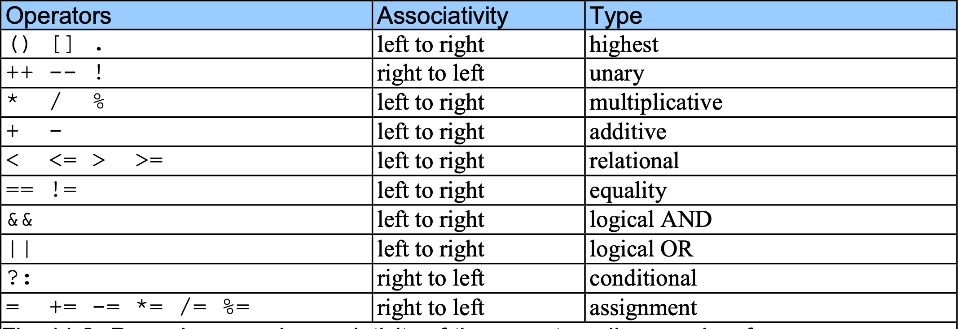
2 Arrays

Slide 7
3 Declaring and Allocating Arrays
Arrays in memory
Objects
Operator new
Allocates memory for objects
Dynamic memory allocation operator
var c; c = new Array( 12 );

Slide 8
4 Examples Using Arrays
Arrays grow dynamically
Allocate more space as items are added
Must initialize array elements
Default value is undefined
for loops convenient
Referring to uninitialized elements or elements outside array bounds is an error

Slide 9
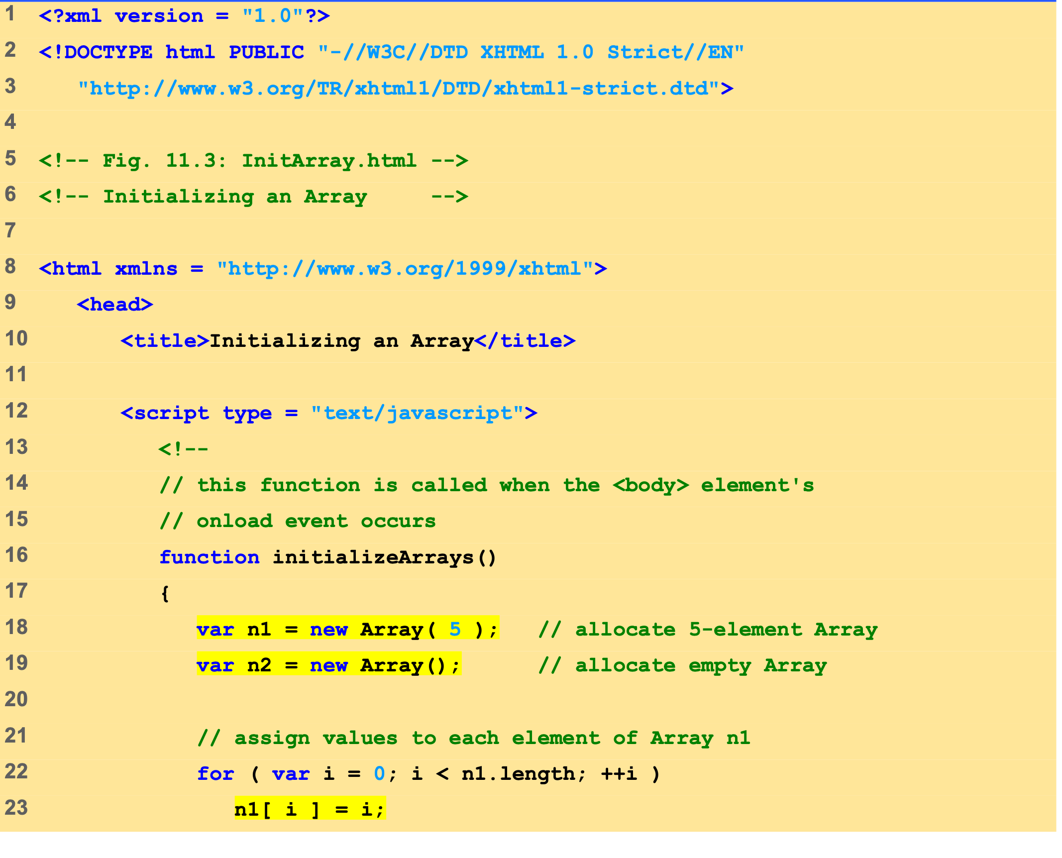
InitArray.html (1 of 3)
Array n1 has five elements.
Array n2 is an empty array.
The for loop initializes the elements in n1 to their subscript numbers (0 to 4).

Slide 10
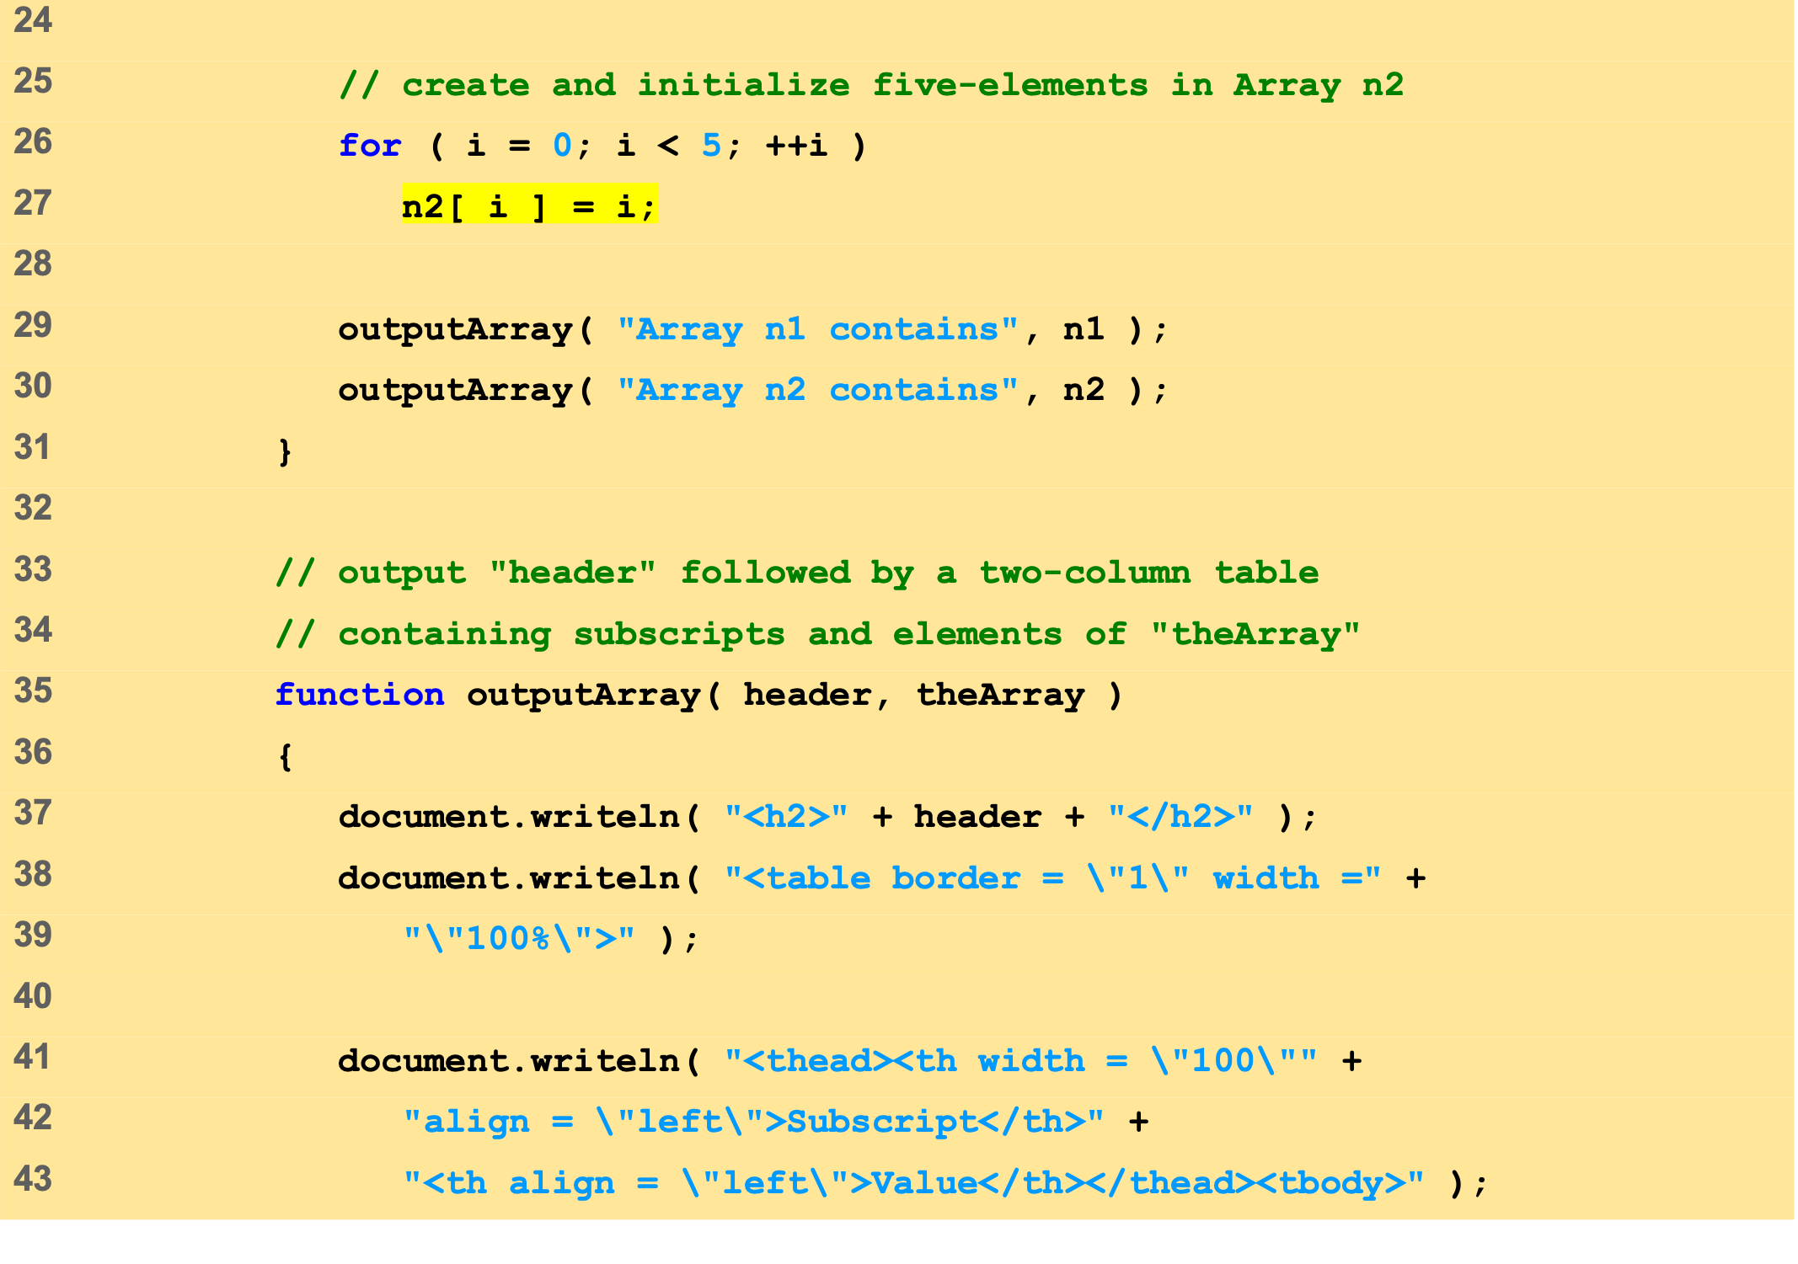
InitArray.html (1 of 3)
The for loop adds five elements to Array n2 and initialize each element to its subscript number (0 to 4).
Each function displays the contents of its respective Array in an XHTML table.
The second time function ouputArray is called, variable header gets the value of “Array n2 contains” and variable theArray gets the value of n2.
The first time function ouputArray is called, variable header gets the value of “Array n1 contains” and variable theArray gets the value of n1.

Slide 11
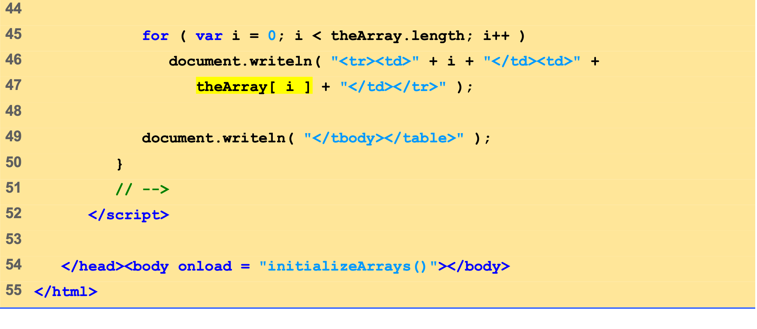
InitArray.html (1 of 3)

Slide 12
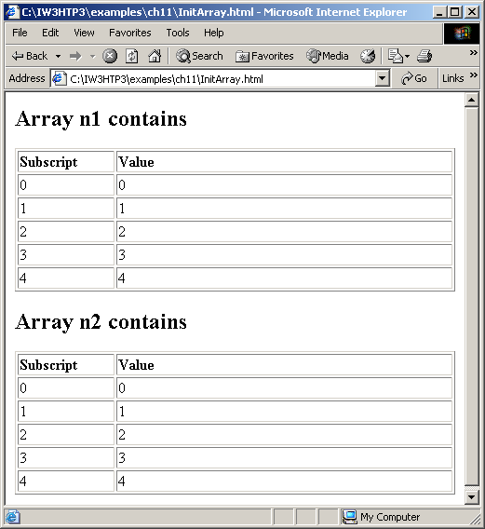
4 Examples Using Arrays
Initializing the elements of an array.

Slide 13
4 Examples Using Arrays
Possible to declare and initialize in one step
Specify list of values
Initializer list
var n = [ 10, 20, 30, 40, 50 ]; var n = new Array( 10, 20, 30, 40, 50 );
Also possible to only initialize some values
Leave uninitialized elements blank
Uninitialized elements default to “undefined”
var n = [ 10, 20, , 40, 50 ];

Slide 14
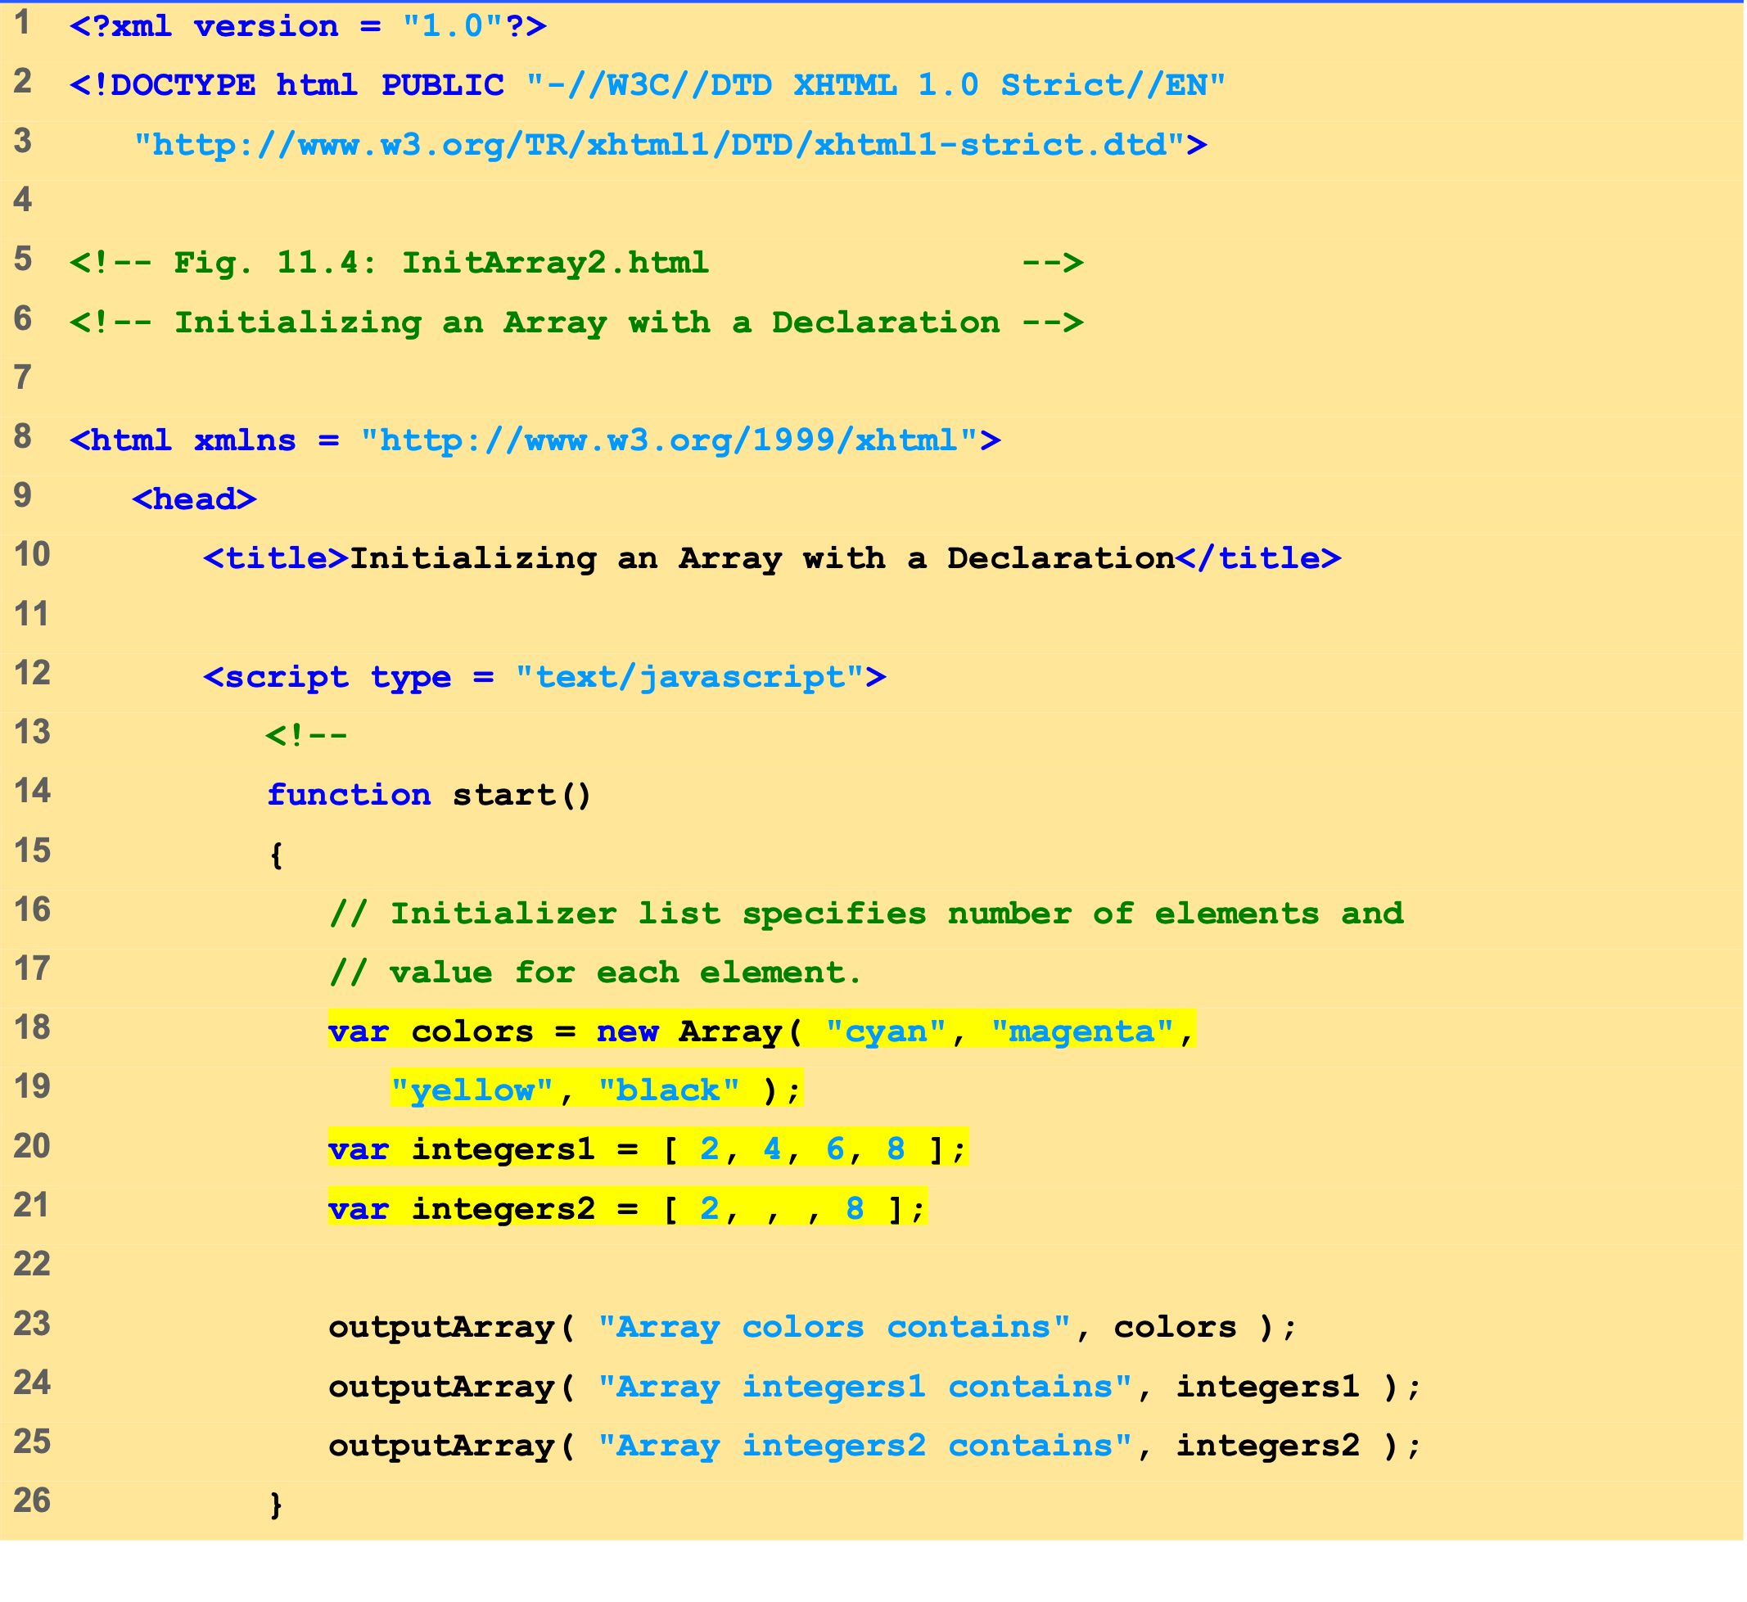
InitArray2.html (1 of 2)
Array integers1 is initialized using an initializer list.
Two values are not supplied for integers2, which will be displayed as undefined.

Slide 15
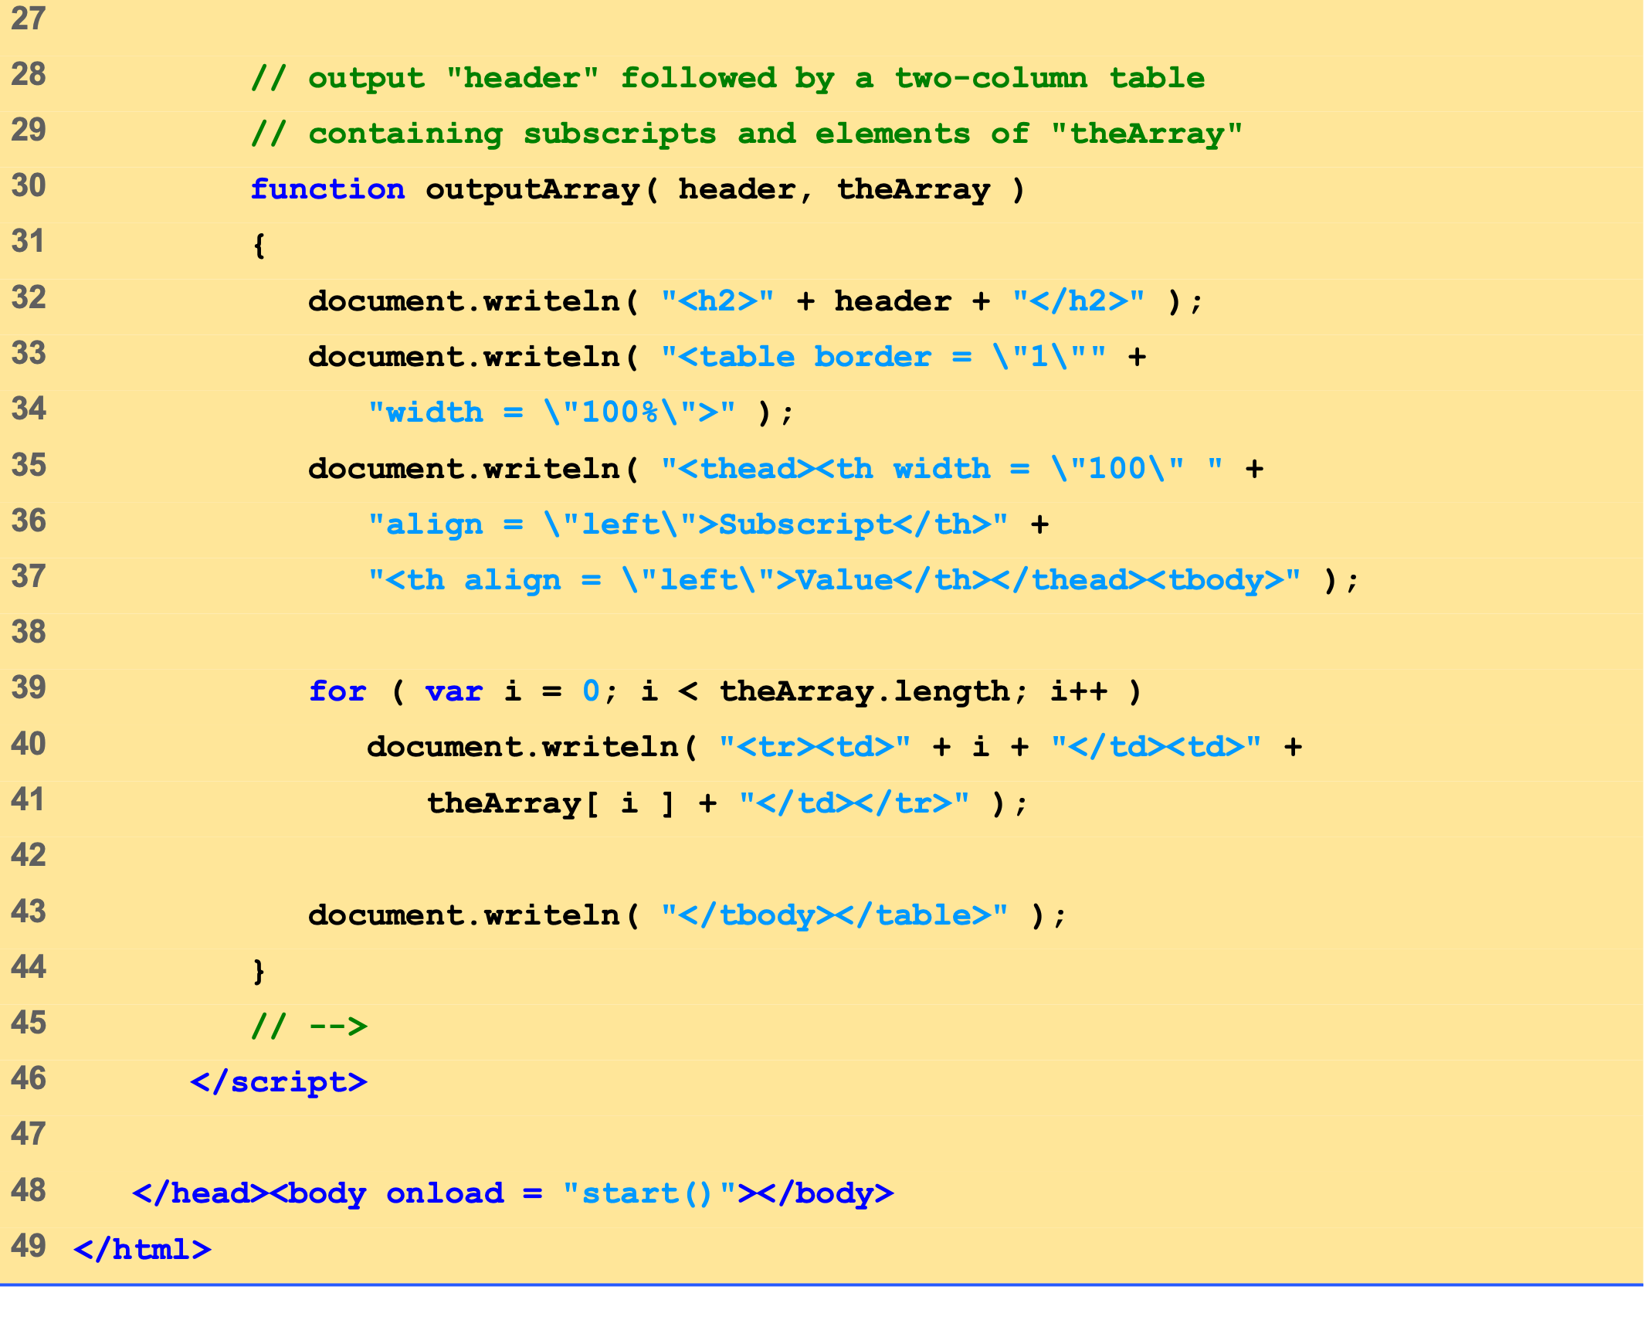
InitArray2.html (2 of 2)

Slide 16
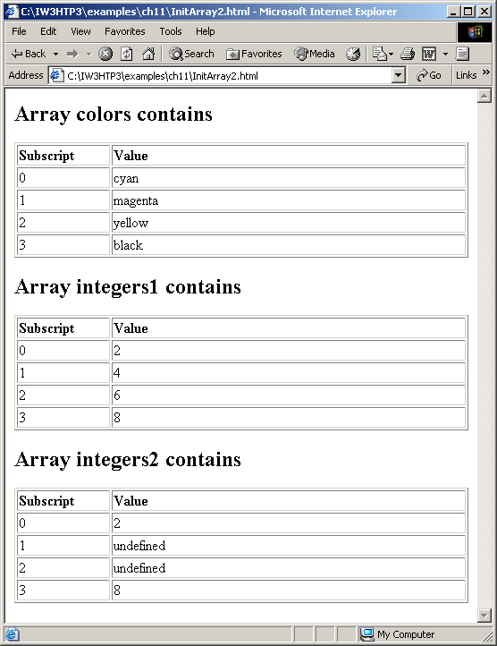
4 Examples Using Arrays
Initializing the elements of an array.

Slide 17
4 Examples Using Arrays
for…in statement
Perform an action for each element in an array
Iterates over array elements
Assigns each element to specified variable one at a time
Ignores non-existent elements

Slide 18
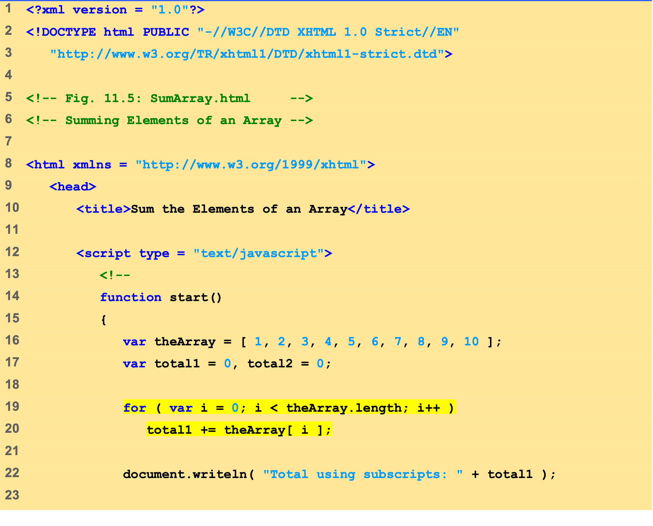
SumArray.html (1 of 2)
The for loop sums the values contained in the 10-element integer array called theArray.

Slide 19
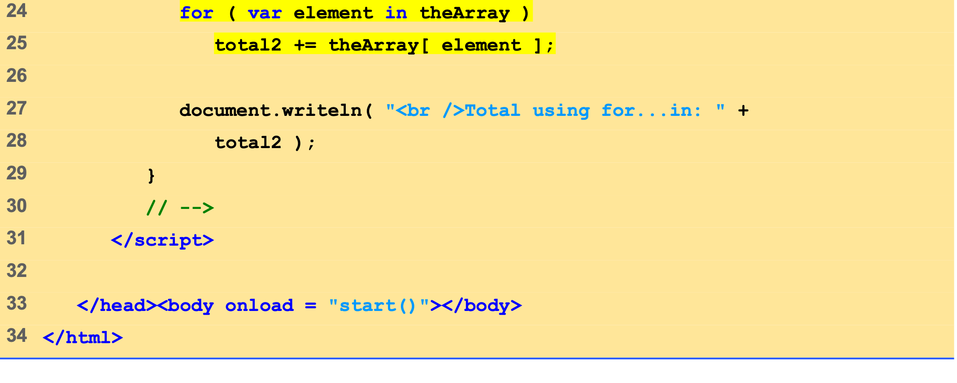
SumArray.html (2 of 2)
Variable element is assigned a subscript in the range of 0 up to, but not including, theArray.length.

Slide 20
4 Examples Using Arrays
Calculating the sum of the elements of an array.

Slide 21
4 Examples Using Arrays
Arrays can provide shorter and cleaner substitute for switch statements
Each element represents one case

Slide 22
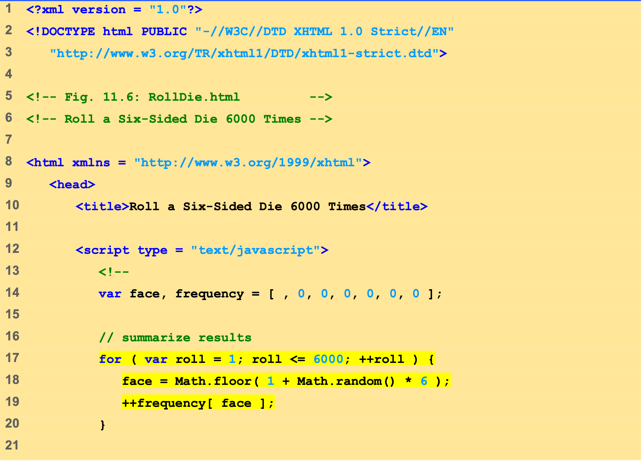
RollDie.html (1 of 2)
Referencing Array frequency replaces the switch statement used in Chapter 10’s example.

Slide 23
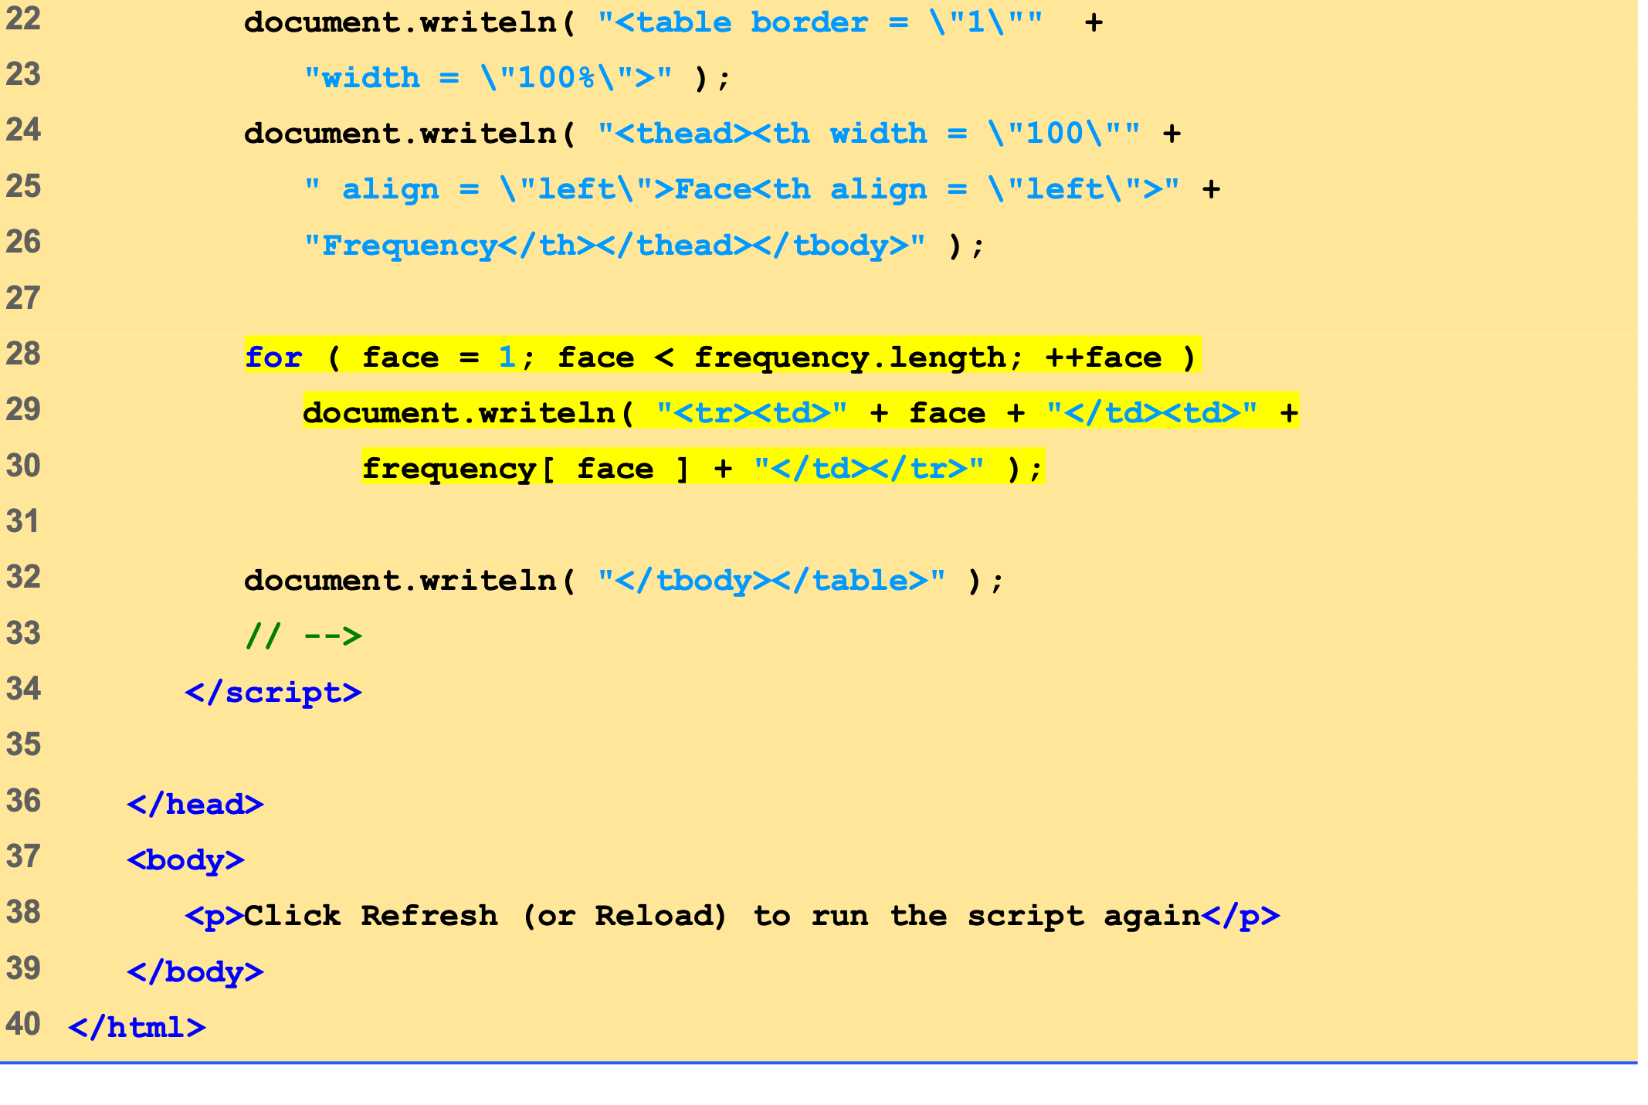
RollDie.html (2 of 2)

Slide 24
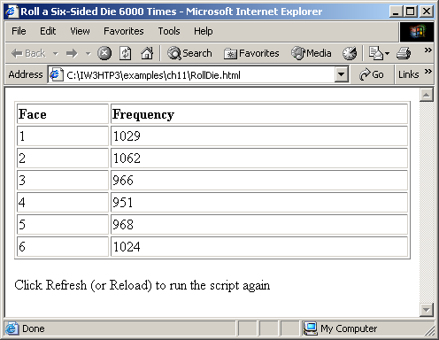
4 Examples Using Arrays
Dice-rolling program using arrays instead of a switch.

Slide 25
5 Random Image Generator Using Arrays
Cleaner approach than previous version
Specify any file name rather than integers 1-7
Result of Math.random call is index into array of image file names

Slide 26
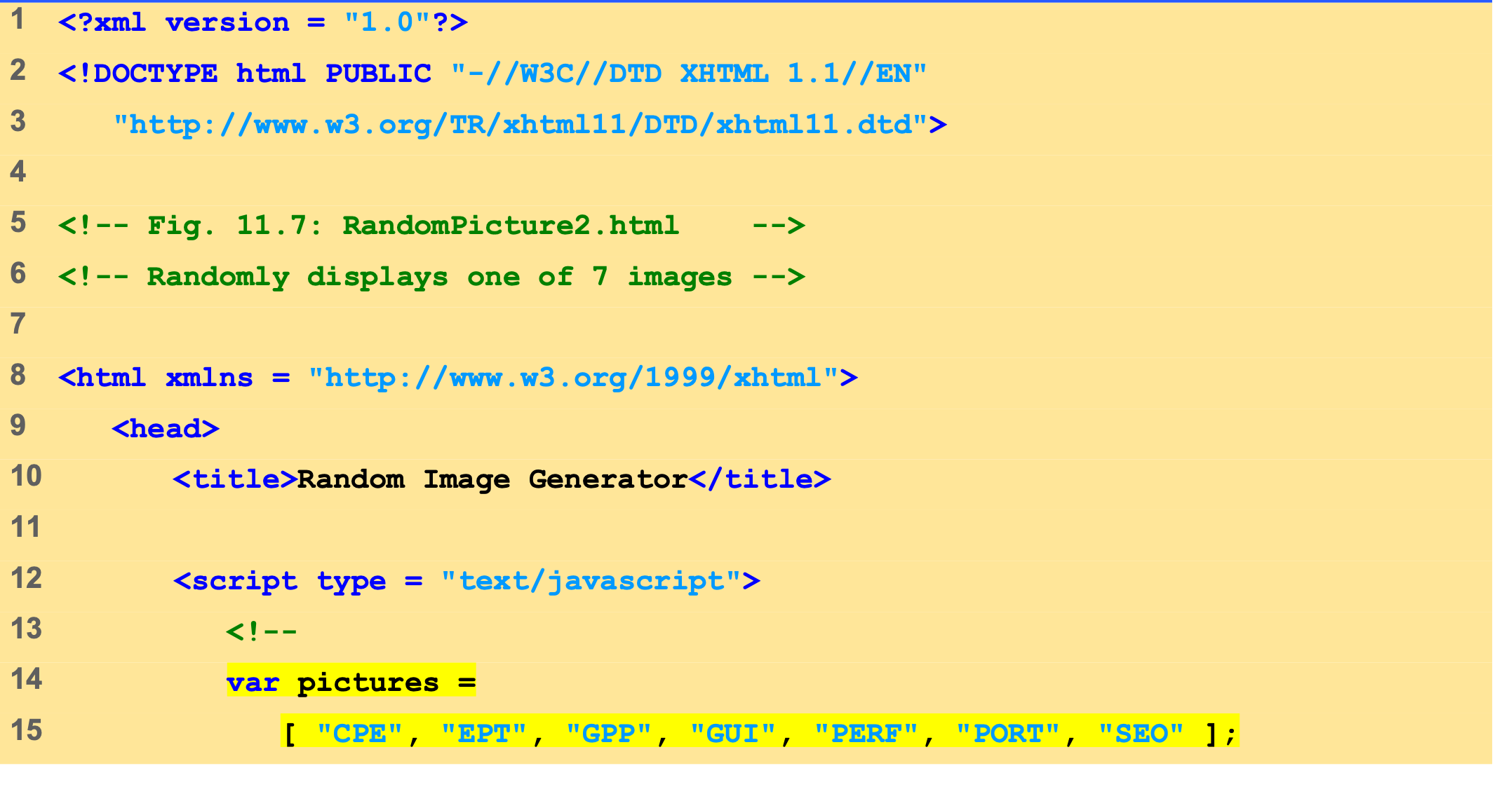
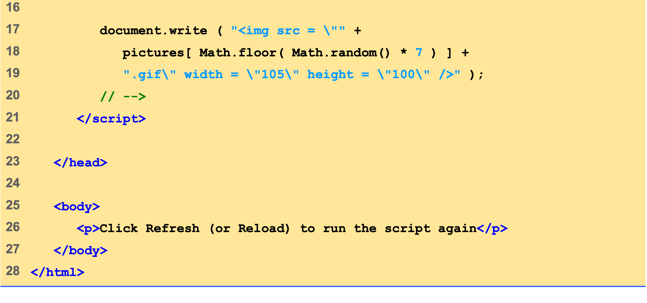
RandomPicture2 .html

Slide 27
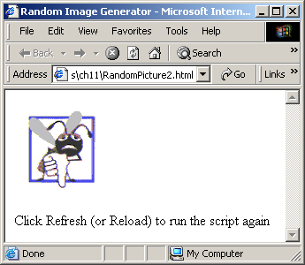
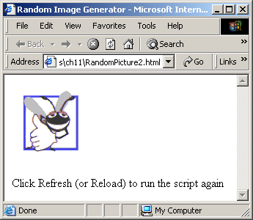
5 Random Image Generator Using Arrays
Random image generation using arrays.

Slide 28
6 References and Reference Parameters
Two ways to pass parameters
Pass-by-value
Pass copy of original value
Default for numbers and booleans
Original variable is unchanged
Pass-by-reference
How objects are passed, like arrays
Pass location in memory of value
Allows direct access to original value
Improves performance

Slide 29
7 Passing Arrays to Functions
Name of array is argument
Not necessary to also pass size of array
Arrays know their size
Passed by reference
Individual elements are passed by value if numbers or booleans
Array.join
Creates string containing all array elements
Specify separator

Slide 30
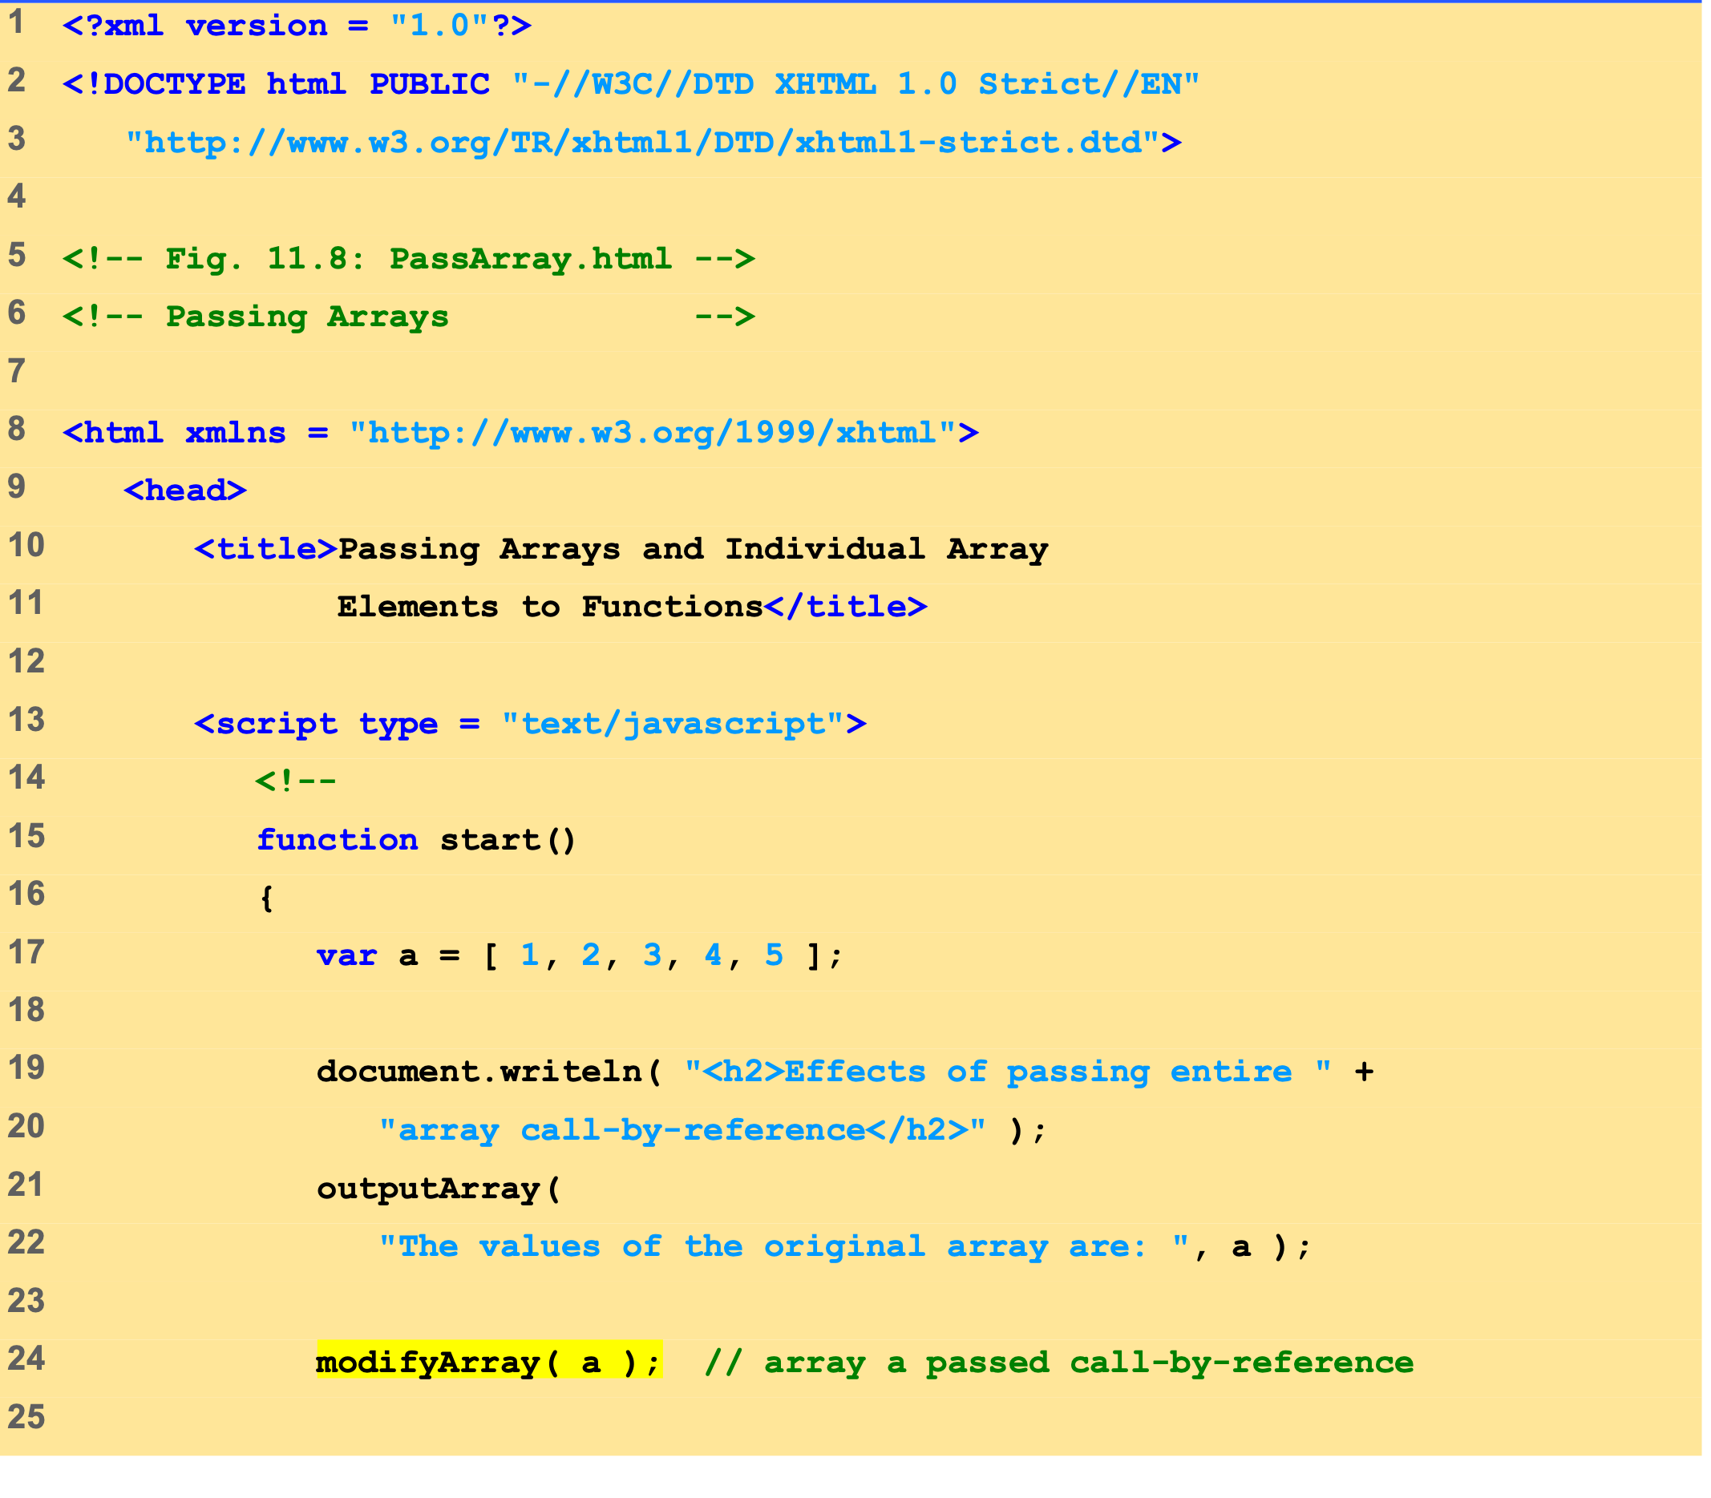
PassArray.html (1 of 3)
The first call to function outputArray displays the contents of the Array a before it is modified.
Function modifyArray multiplies each element by 2.

Slide 31
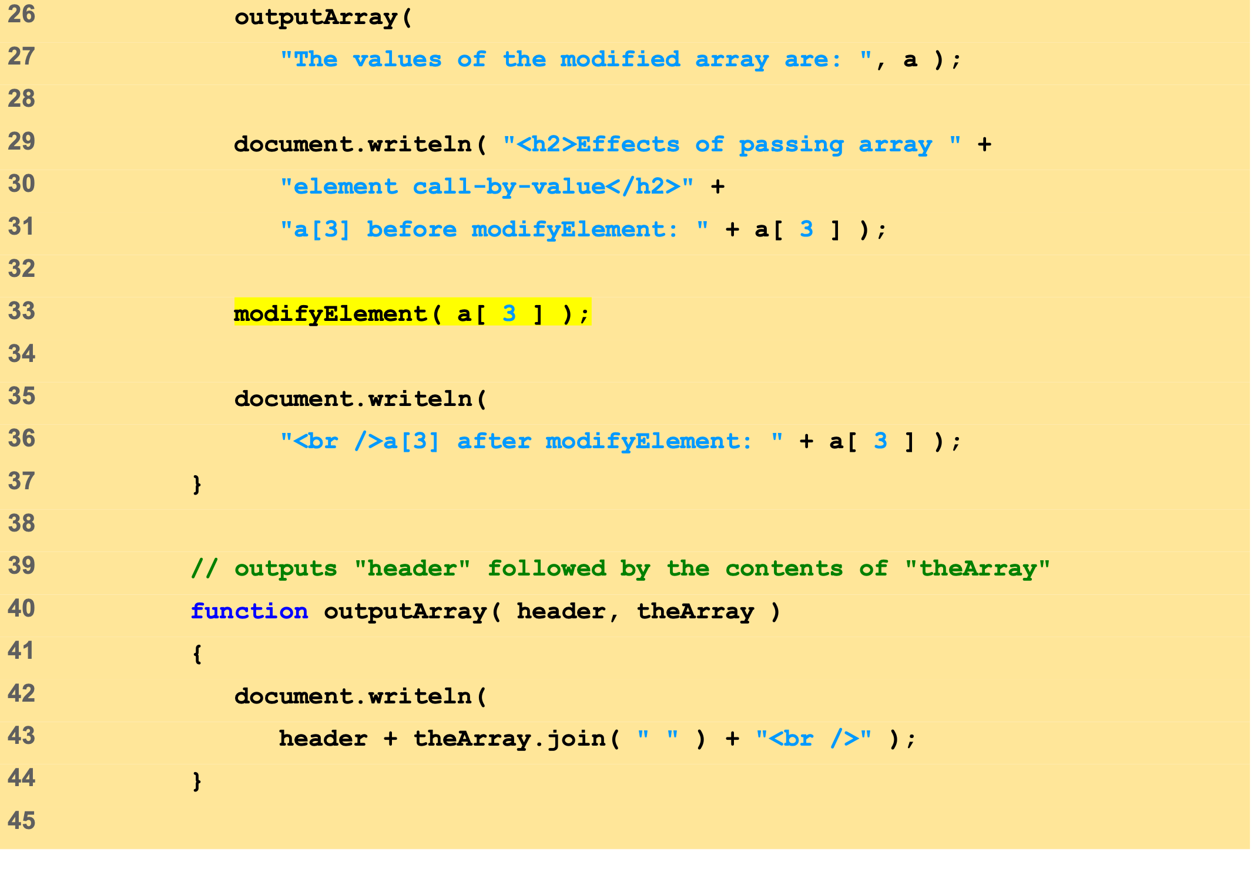
PassArray.html (2 of 3)
Again, function outputArray is called to show that the contents of Array a have been modified.
Function modifyElement multiplies the contents of a[ 3 ] by 2.
The value of a[ 3 ] is output to show its contents before it is modified.
Method join takes as its argument a string containing a separator that should be used to separate the elements of the array in the string that is returned.

Slide 32
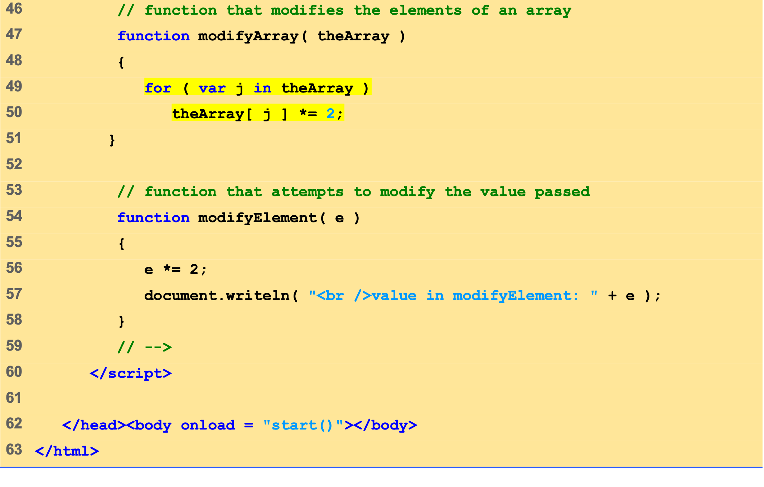
PassArray.html (3 of 3)
Multiply each element in theArray by 2.

Slide 33
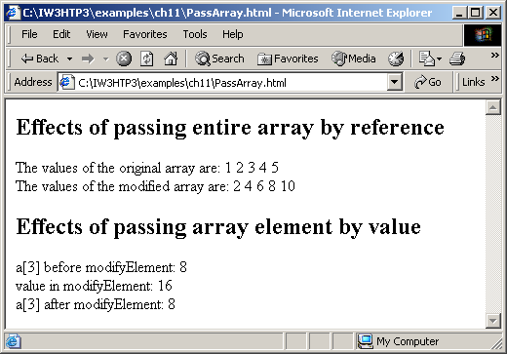
7 Passing Arrays to Functions
Passing arrays and individual array elements to functions.

Slide 34
8 Sorting Arrays
Sorting
Important computing task
Array.sort
Defaults to string comparison
Optional comparator function
Return negative if first argument less than second
Return zero if arguments equal
Return positive if first argument greater than second

Slide 35
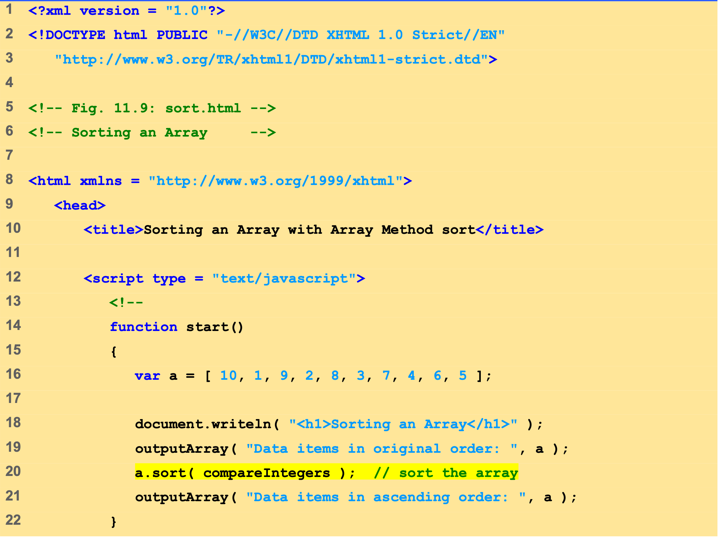
Sort.html (1 of 2)
Method sort takes as its optional argument the name of a function that compares two arguments and returns a value of –1, 0 or 1.

Slide 36
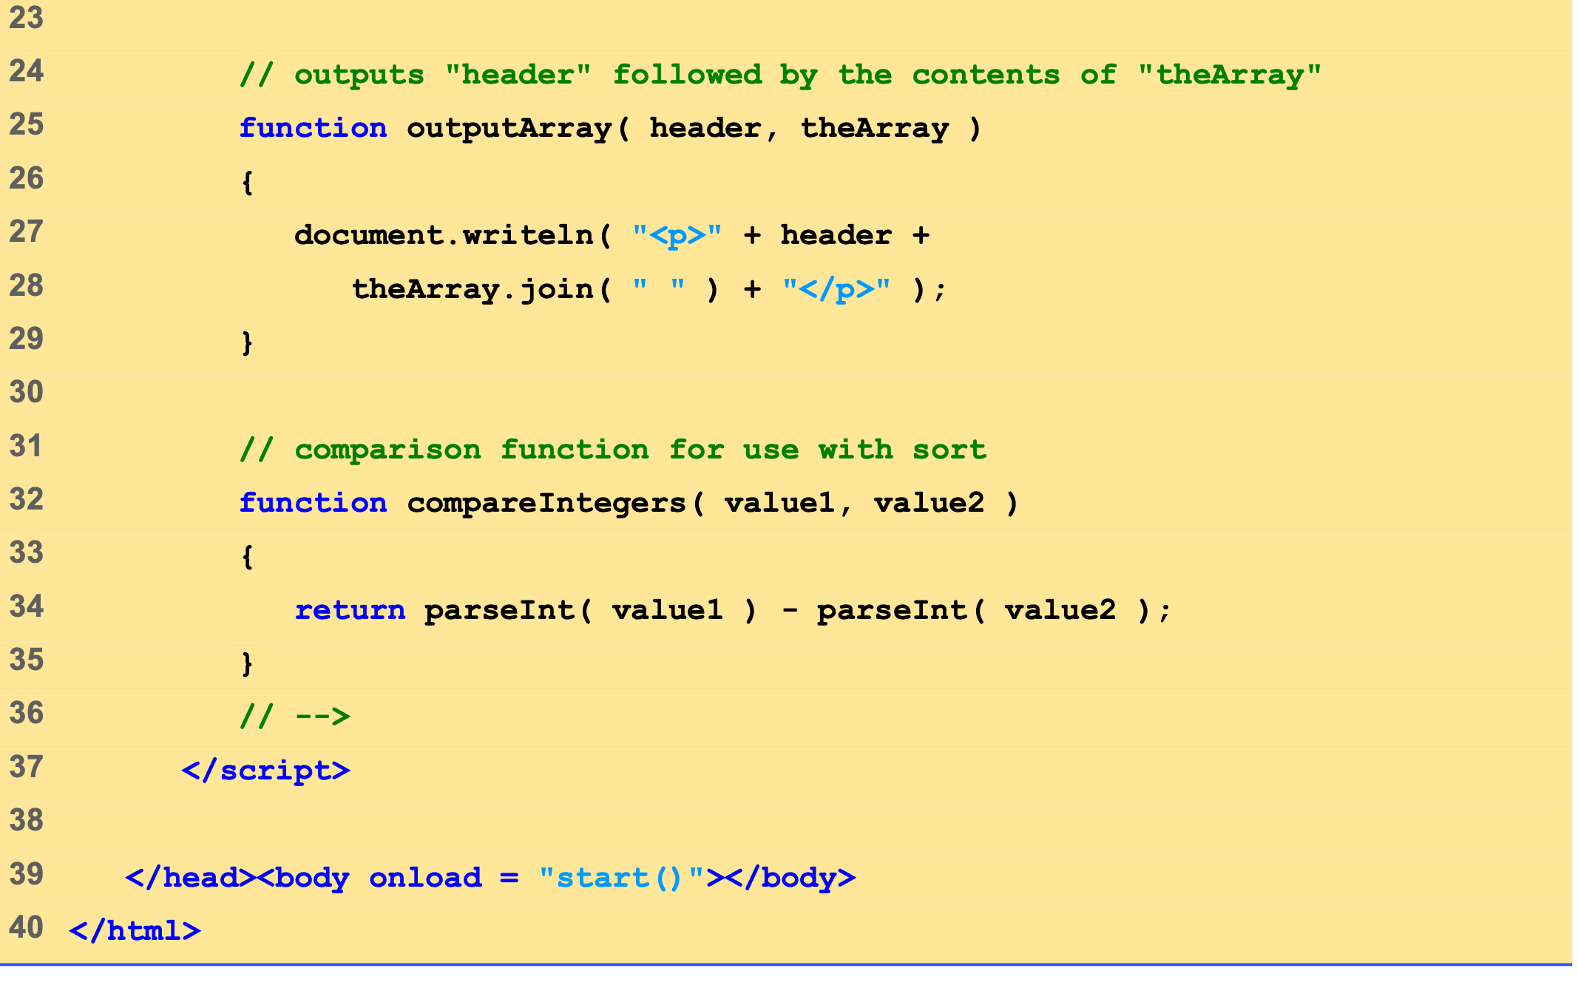
Sort.html (2 of 2)
Function compareIntegers calculates the difference between the integer values of its arguments.

Slide 37
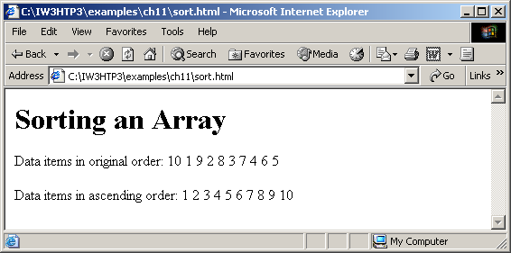
8 Sorting Arrays
Sorting an array with sort.

Slide 38
9 Searching Arrays: Linear Search and Binary Search
Searching
Look for matching key value
Linear search
Iterate through each element until match found
Inefficient
Worst case scenario, must test entire array
Binary search
Requires sorted data
Cuts search range in half each iteration
Efficient
Only look at small fraction of elements

Slide 39
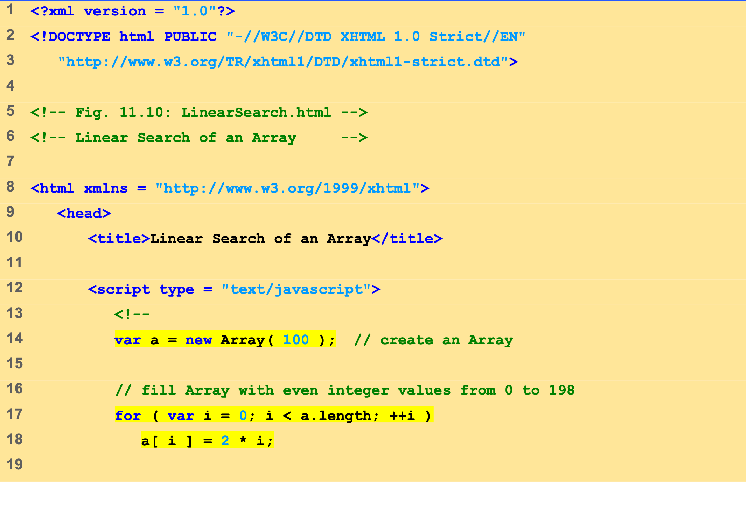
LinearSearch.html (1 of 3)
Array a is initiated with 100 elements.
Array a is populated with the even integers 0 to 198.

Slide 40
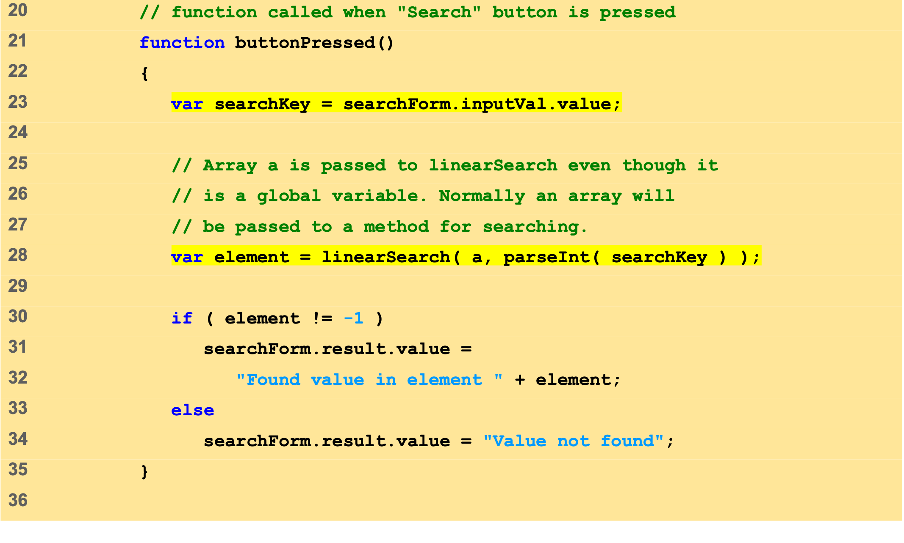
LinearSearch.html (2 of 3)
Get value of search key from the input field in the XHTML form.
Calling function linearSearch and passing it the Array a and the value of variable searchKey as an integer.

Slide 41
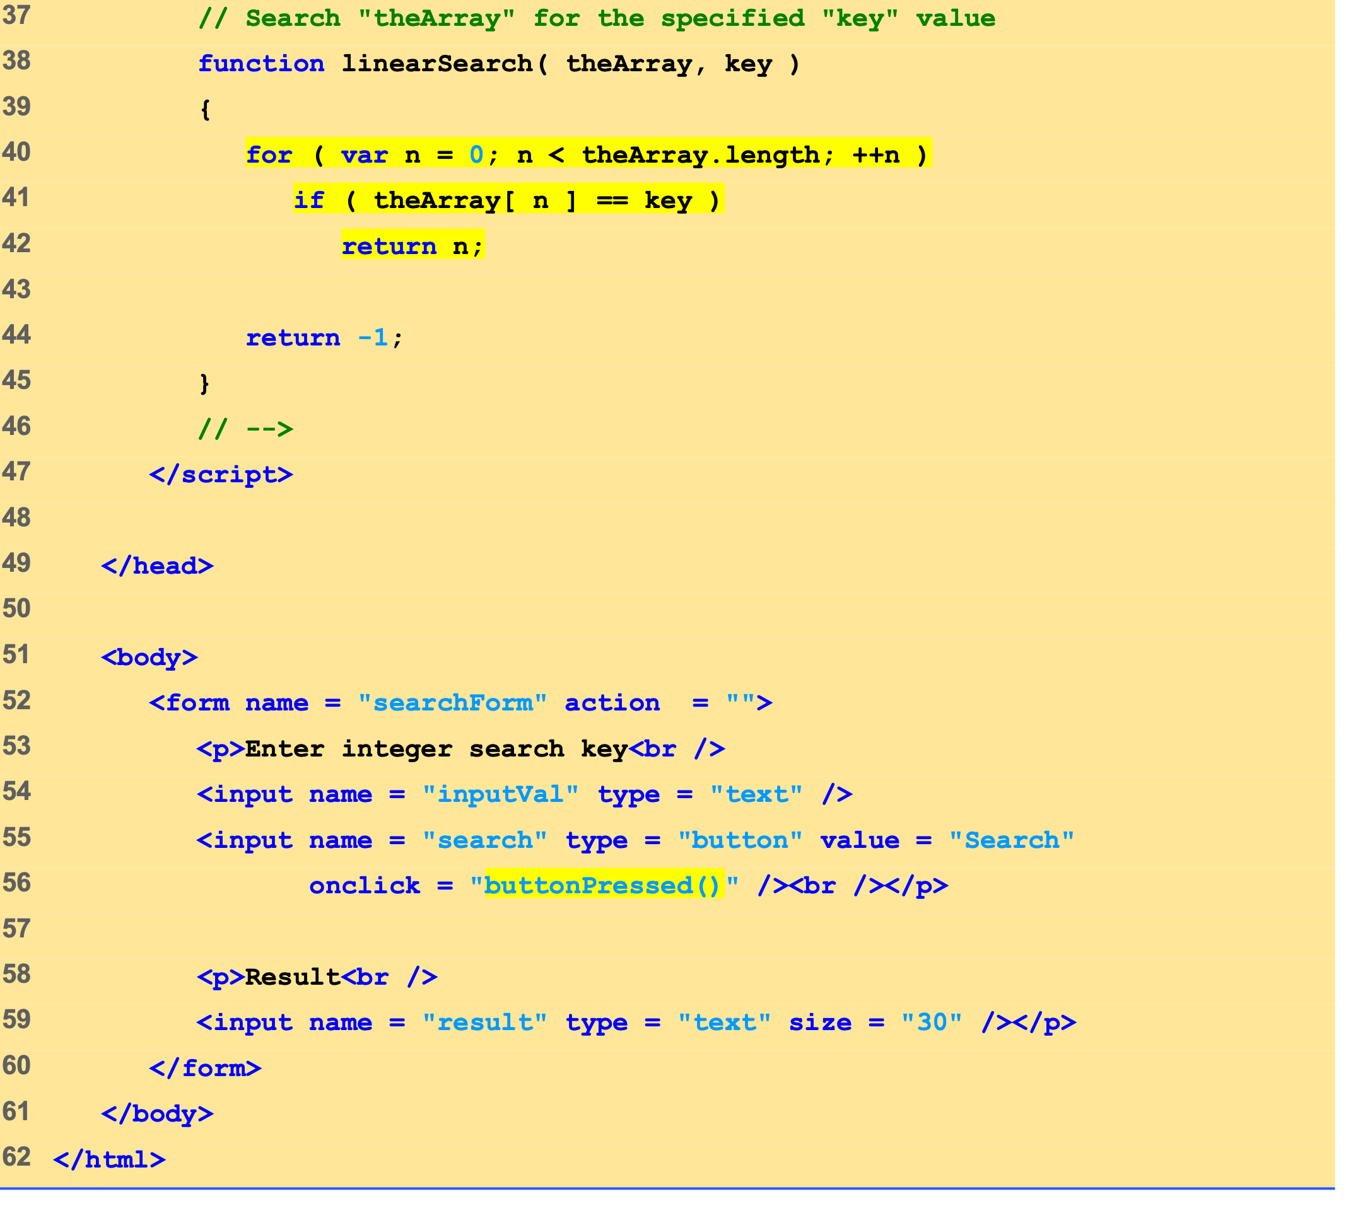
LinearSearch.html (3 of 3)
Variable theArray gets the value of Array a and variable key gets the value of variable searchKey.
Function linearSearch compares each each element with a search key.

Slide 42
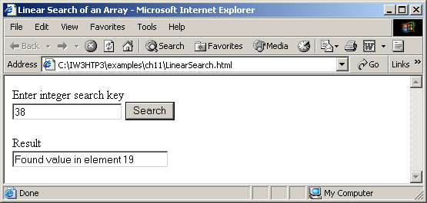
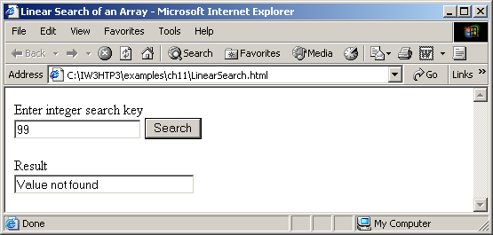
9 Searching Arrays: Linear Search and Binary Search
Linear search of an array.

Slide 43
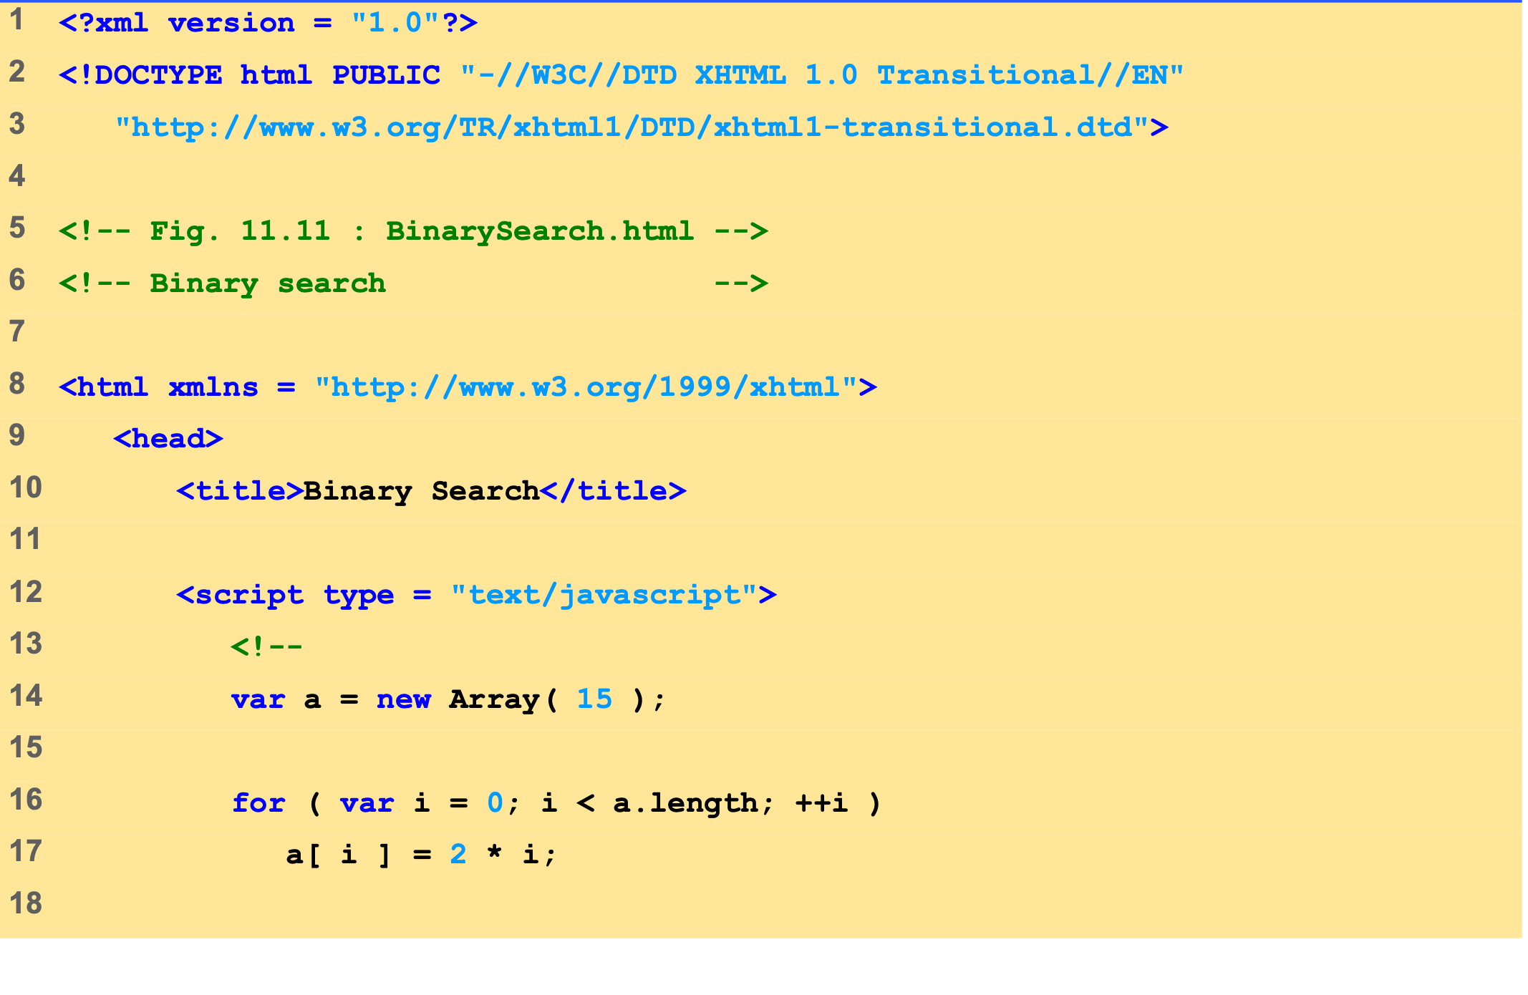
BinarySearch.html (1 of 5)
Array a is initialized with 15 elements.

Slide 44
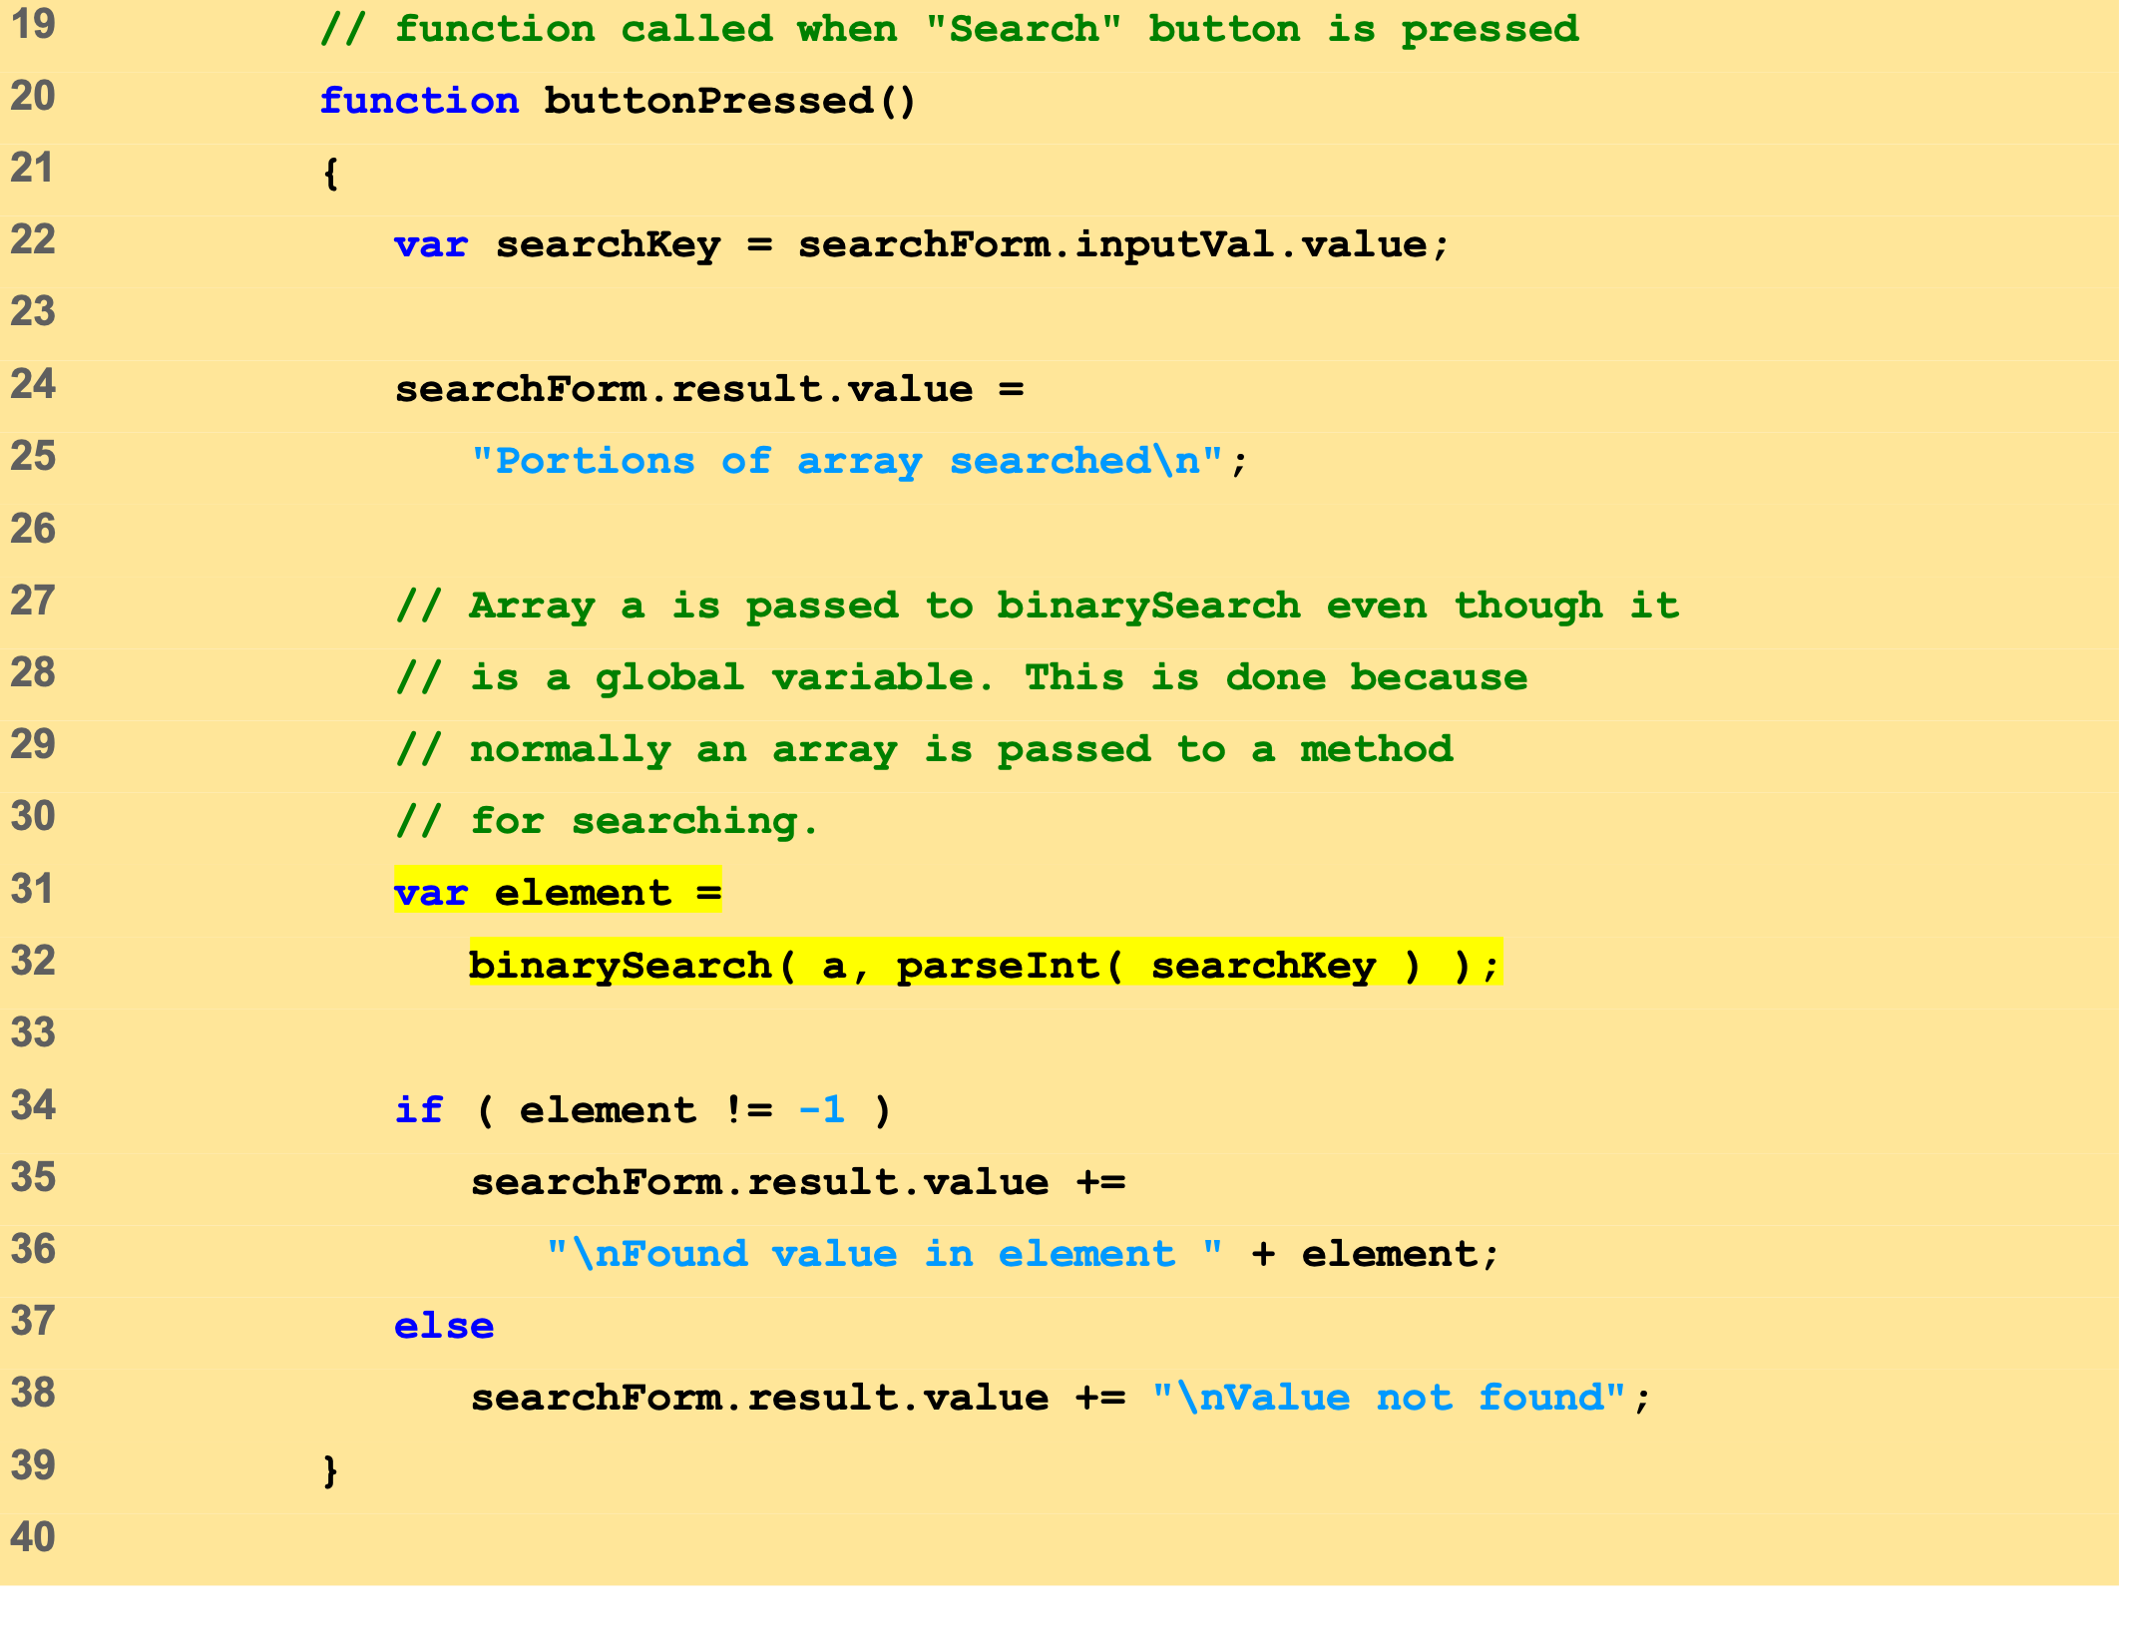
BinarySearch.html (2 of 5)
Function binarySearch receives two arguments: the Array a and the search key, searchKey.

Slide 45
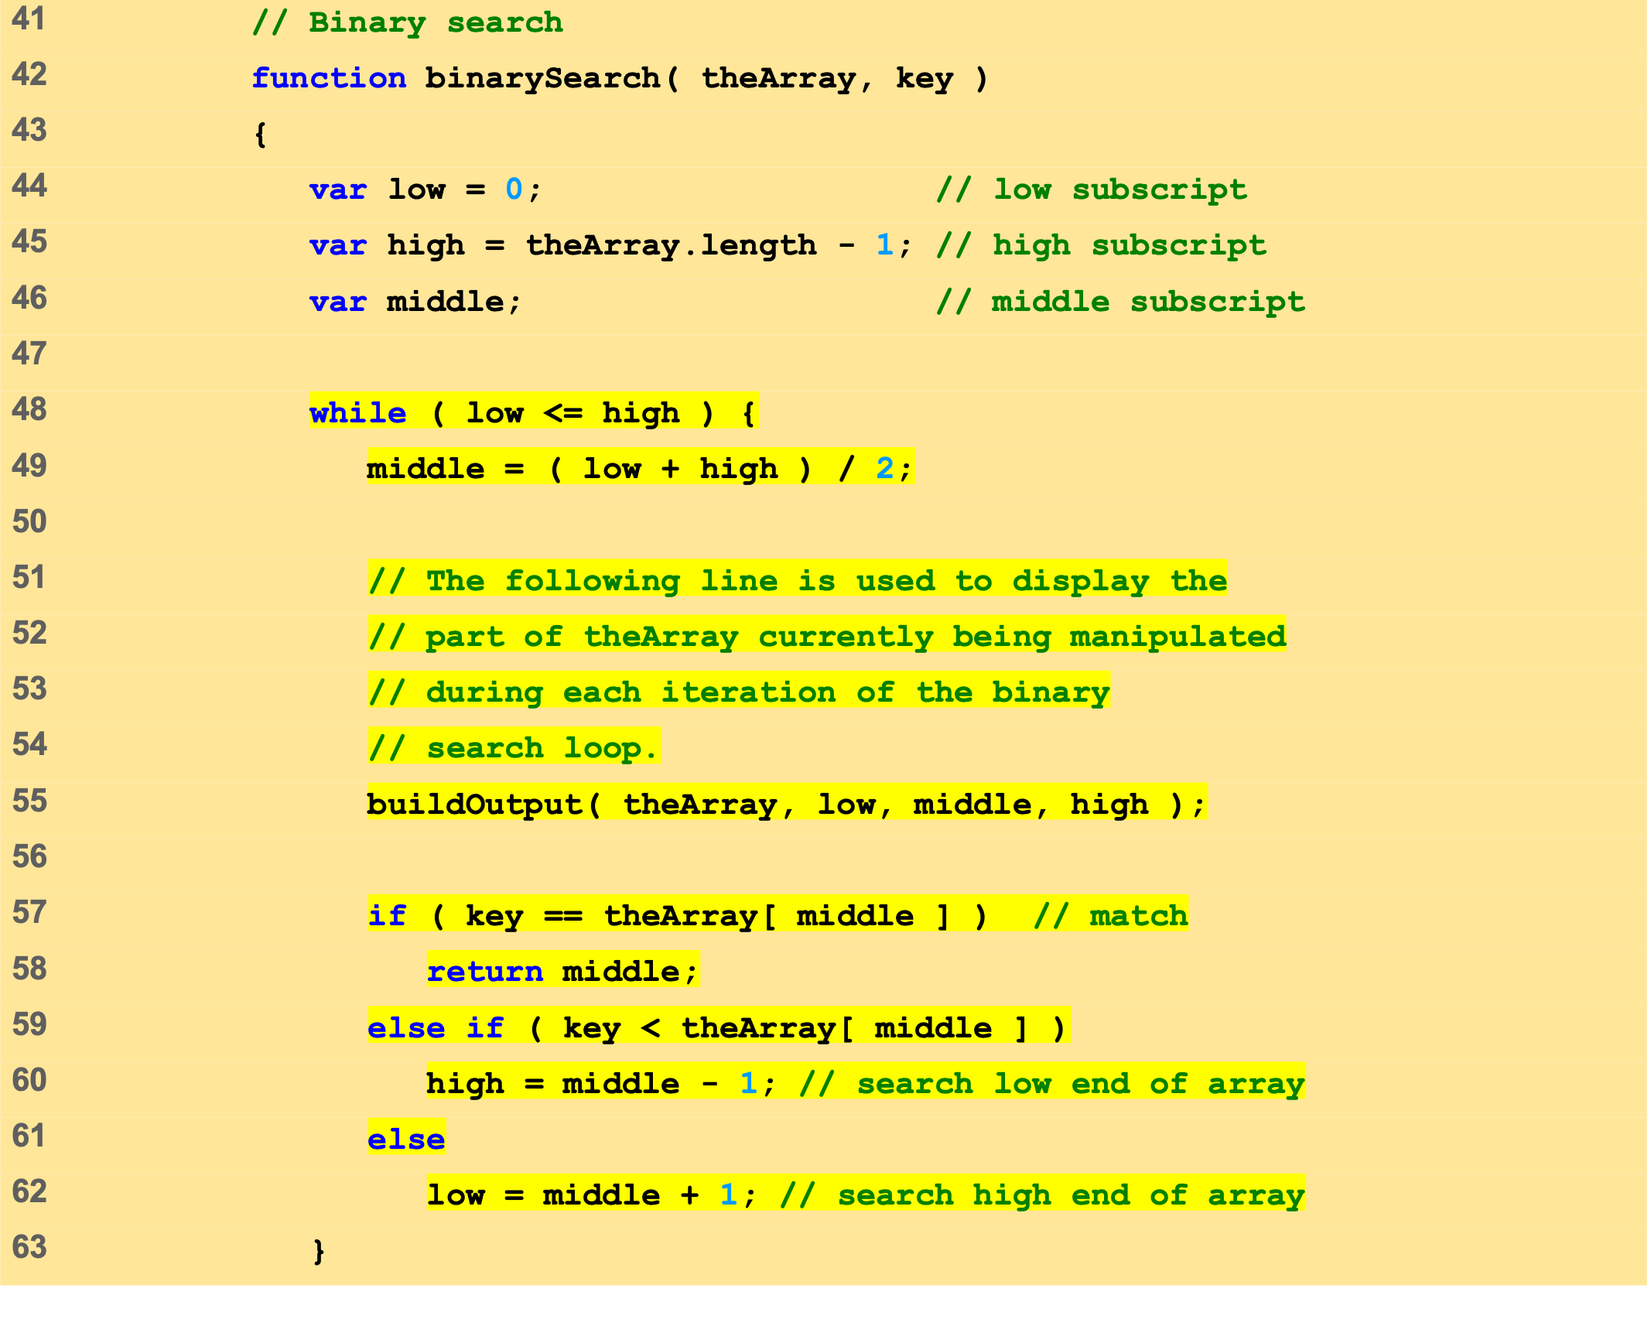
BinarySearch.html (3 of 5)
If the key matches the middle element of a subarray, the subscript of the current element is returned.
If key is less than the middle element, the high subscript is set to middle – 1.
If key is greater then the middle elements, the high subscript is set to middle + 1.

Slide 46
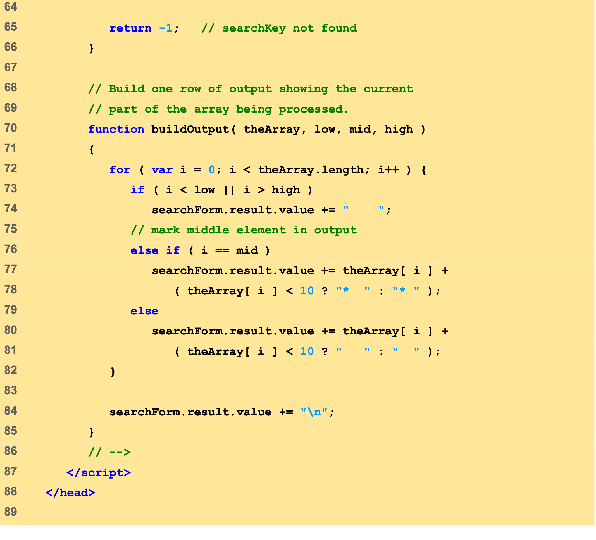
BinarySearch.html (4 of 5)
Function buildOutput creates the markup that displays the results of the search.

Slide 47
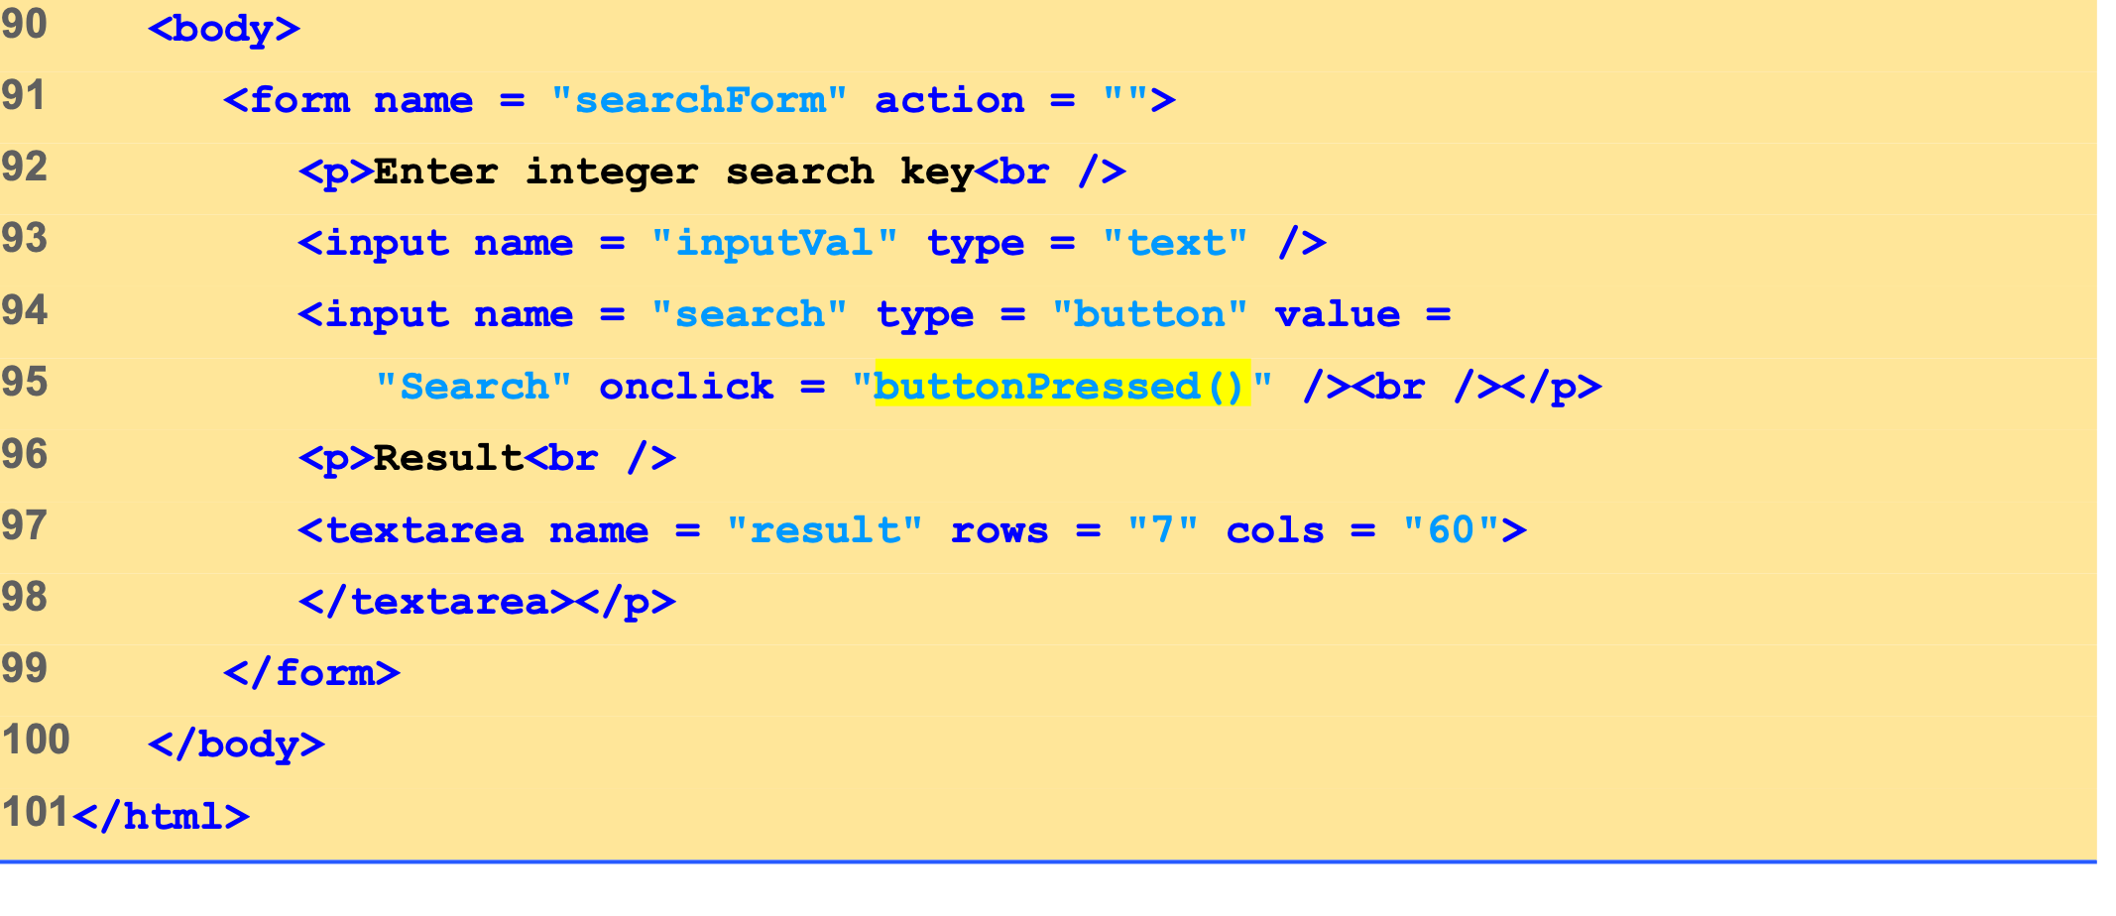
BinarySearch.html (5 of 5)

Slide 48
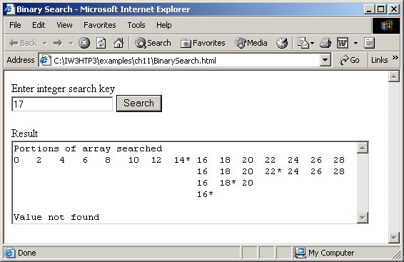
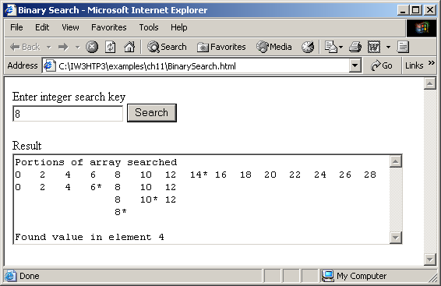
9 Searching Arrays: Linear Search and Binary Search
Binary search of an array.

Slide 49
10 Multidimensional Arrays
Two-dimensional arrays analogous to tables
Rows and columns
Specify row first, then column
Two subscripts

Slide 50
10 Multidimensional Arrays
Column 0
Column 1
Column 2
Column 3
Row 0
a[ 0 ][ 0 ]
a[ 0 ][ 1 ]
a[ 0 ][ 2 ]
a[ 0 ][ 3 ]
Row 1
a[ 1 ][ 0 ]
a[ 1 ][ 1 ]
a[ 1 ][ 2 ]
a[ 1 ][ 3 ]
Row 2
a[ 2 ][ 0 ]
a[ 2 ][ 1 ]
a[ 2 ][ 2 ]
a[ 2 ][ 3 ]
Column subscript (or index)
Row subscript (or index)
Array name
Two-dimensional array with three rows and four columns.

Slide 51
10 Multidimensional Arrays
Declaring and initializing multidimensional arrays
Group by row in square brackets
Treated as arrays of arrays
Creating array b with one row of two elements and a second row of three elements:
var b = [ [ 1, 2 ], [ 3, 4, 5 ] ];

Slide 52
10 Multidimensional Arrays
Also possible to use new operator
Create array b with two rows, first with five columns and second with three:
var b; b = new Array( 2 ); b[ 0 ] = new Array( 5 ); b[ 1 ] = new Array( 3 );

Slide 53
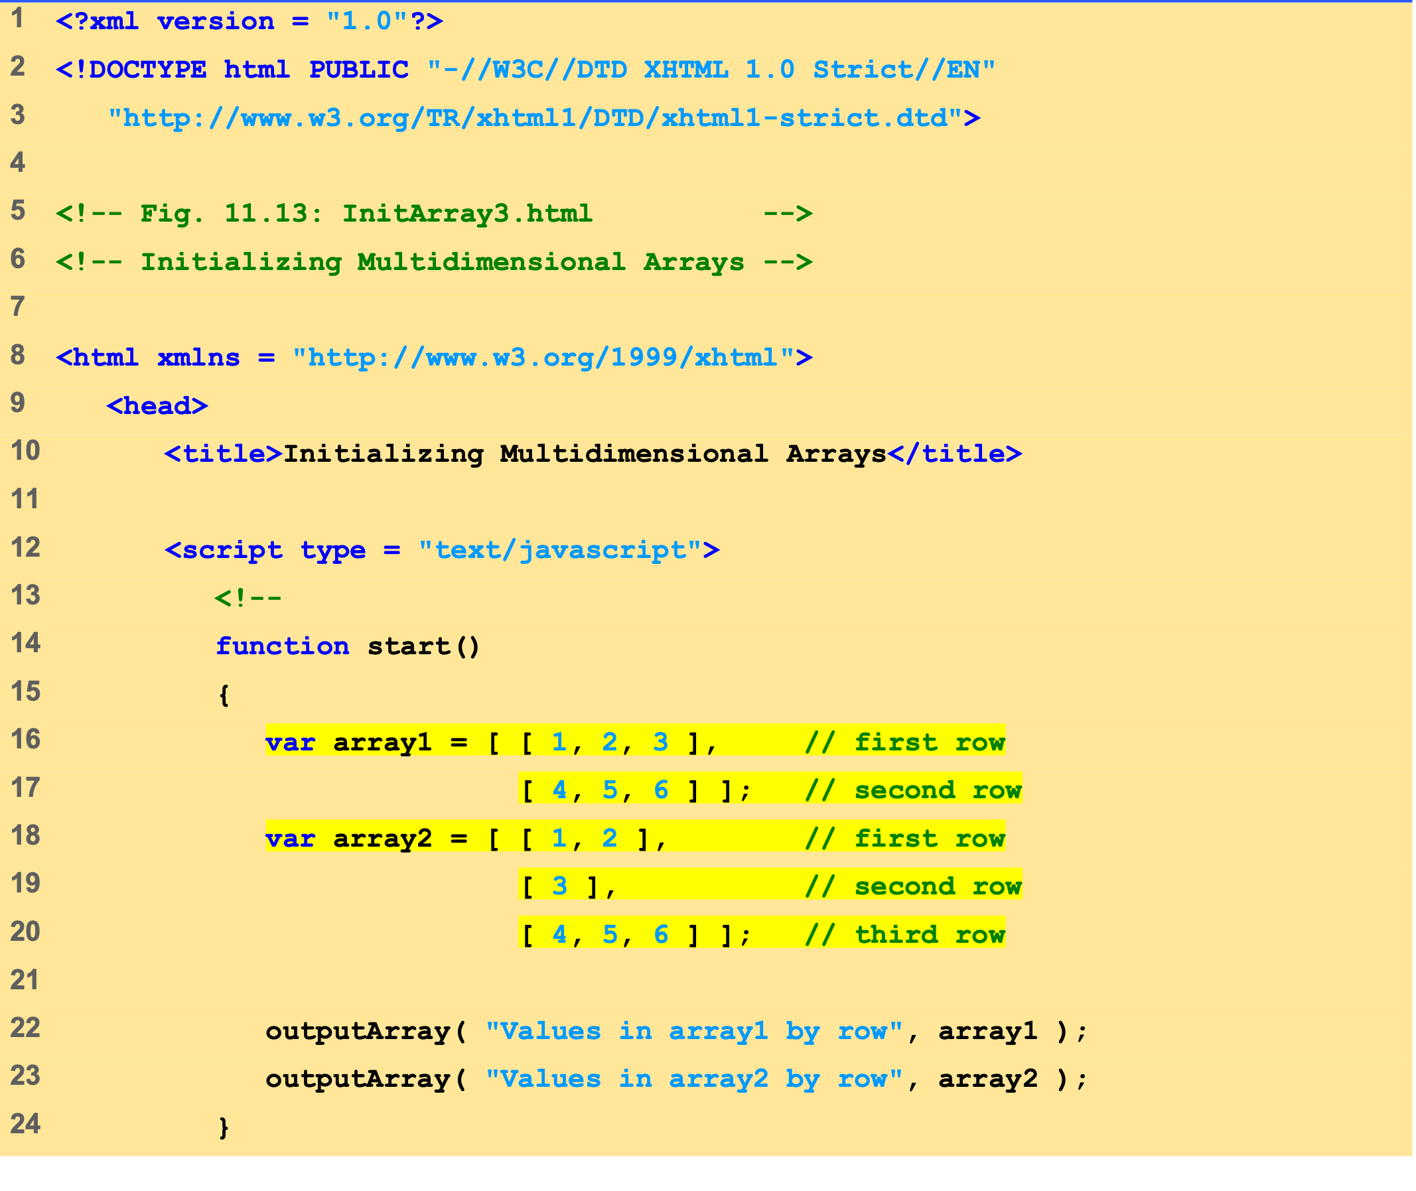
InitArray3.html (1 of 2)
Array array1 provides six initializers in two rows.
Array array2 provides six initializers in three rows.
Function outputArray displays each array’s elements in a Web page.

Slide 54
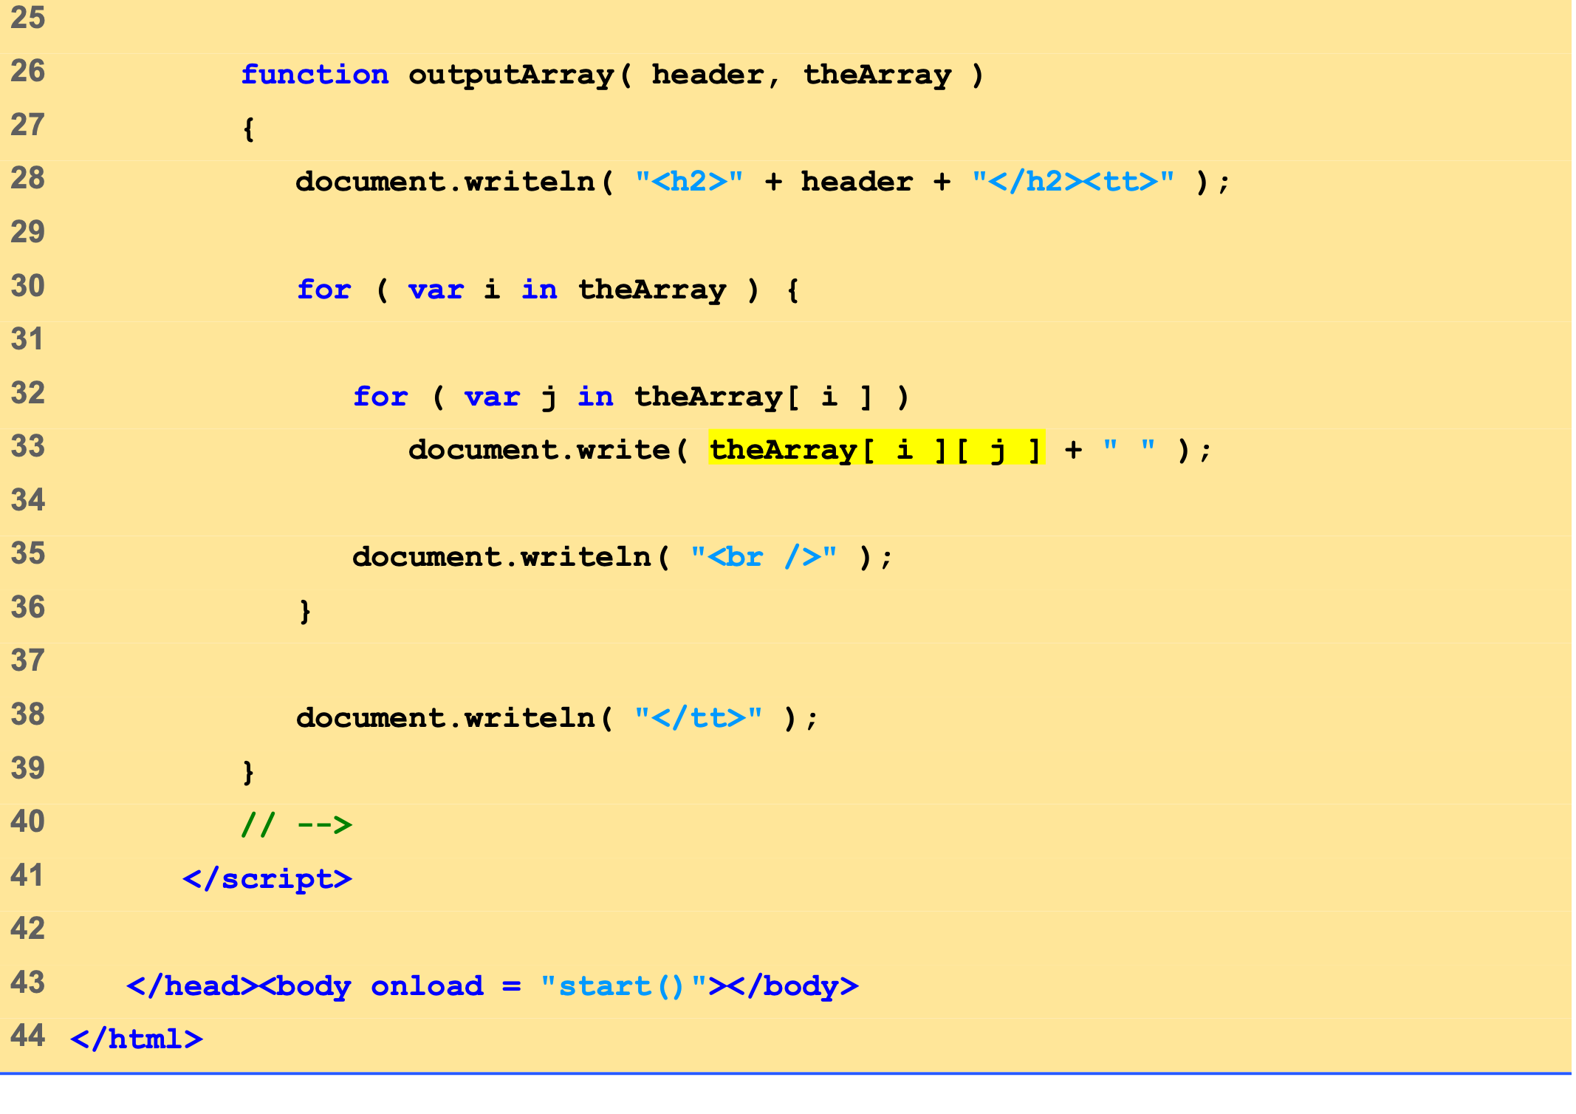
InitArray3.html (2 of 2)
Referencing the multidimensional array theArray.

Slide 55
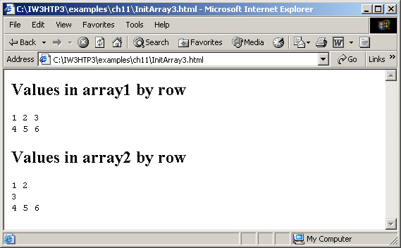
10 Multidimensional Arrays
Initializing multidimensional arrays.

Slide 56
11 Building an Online Quiz
Radio buttons
Represented as an array
Name of radio buttons is name of array
One element per button
checked property is true when selected
XHTML Forms
Contain controls, including radio buttons
action property specifies what happens when submitted
Can call JavaScript code

Slide 57
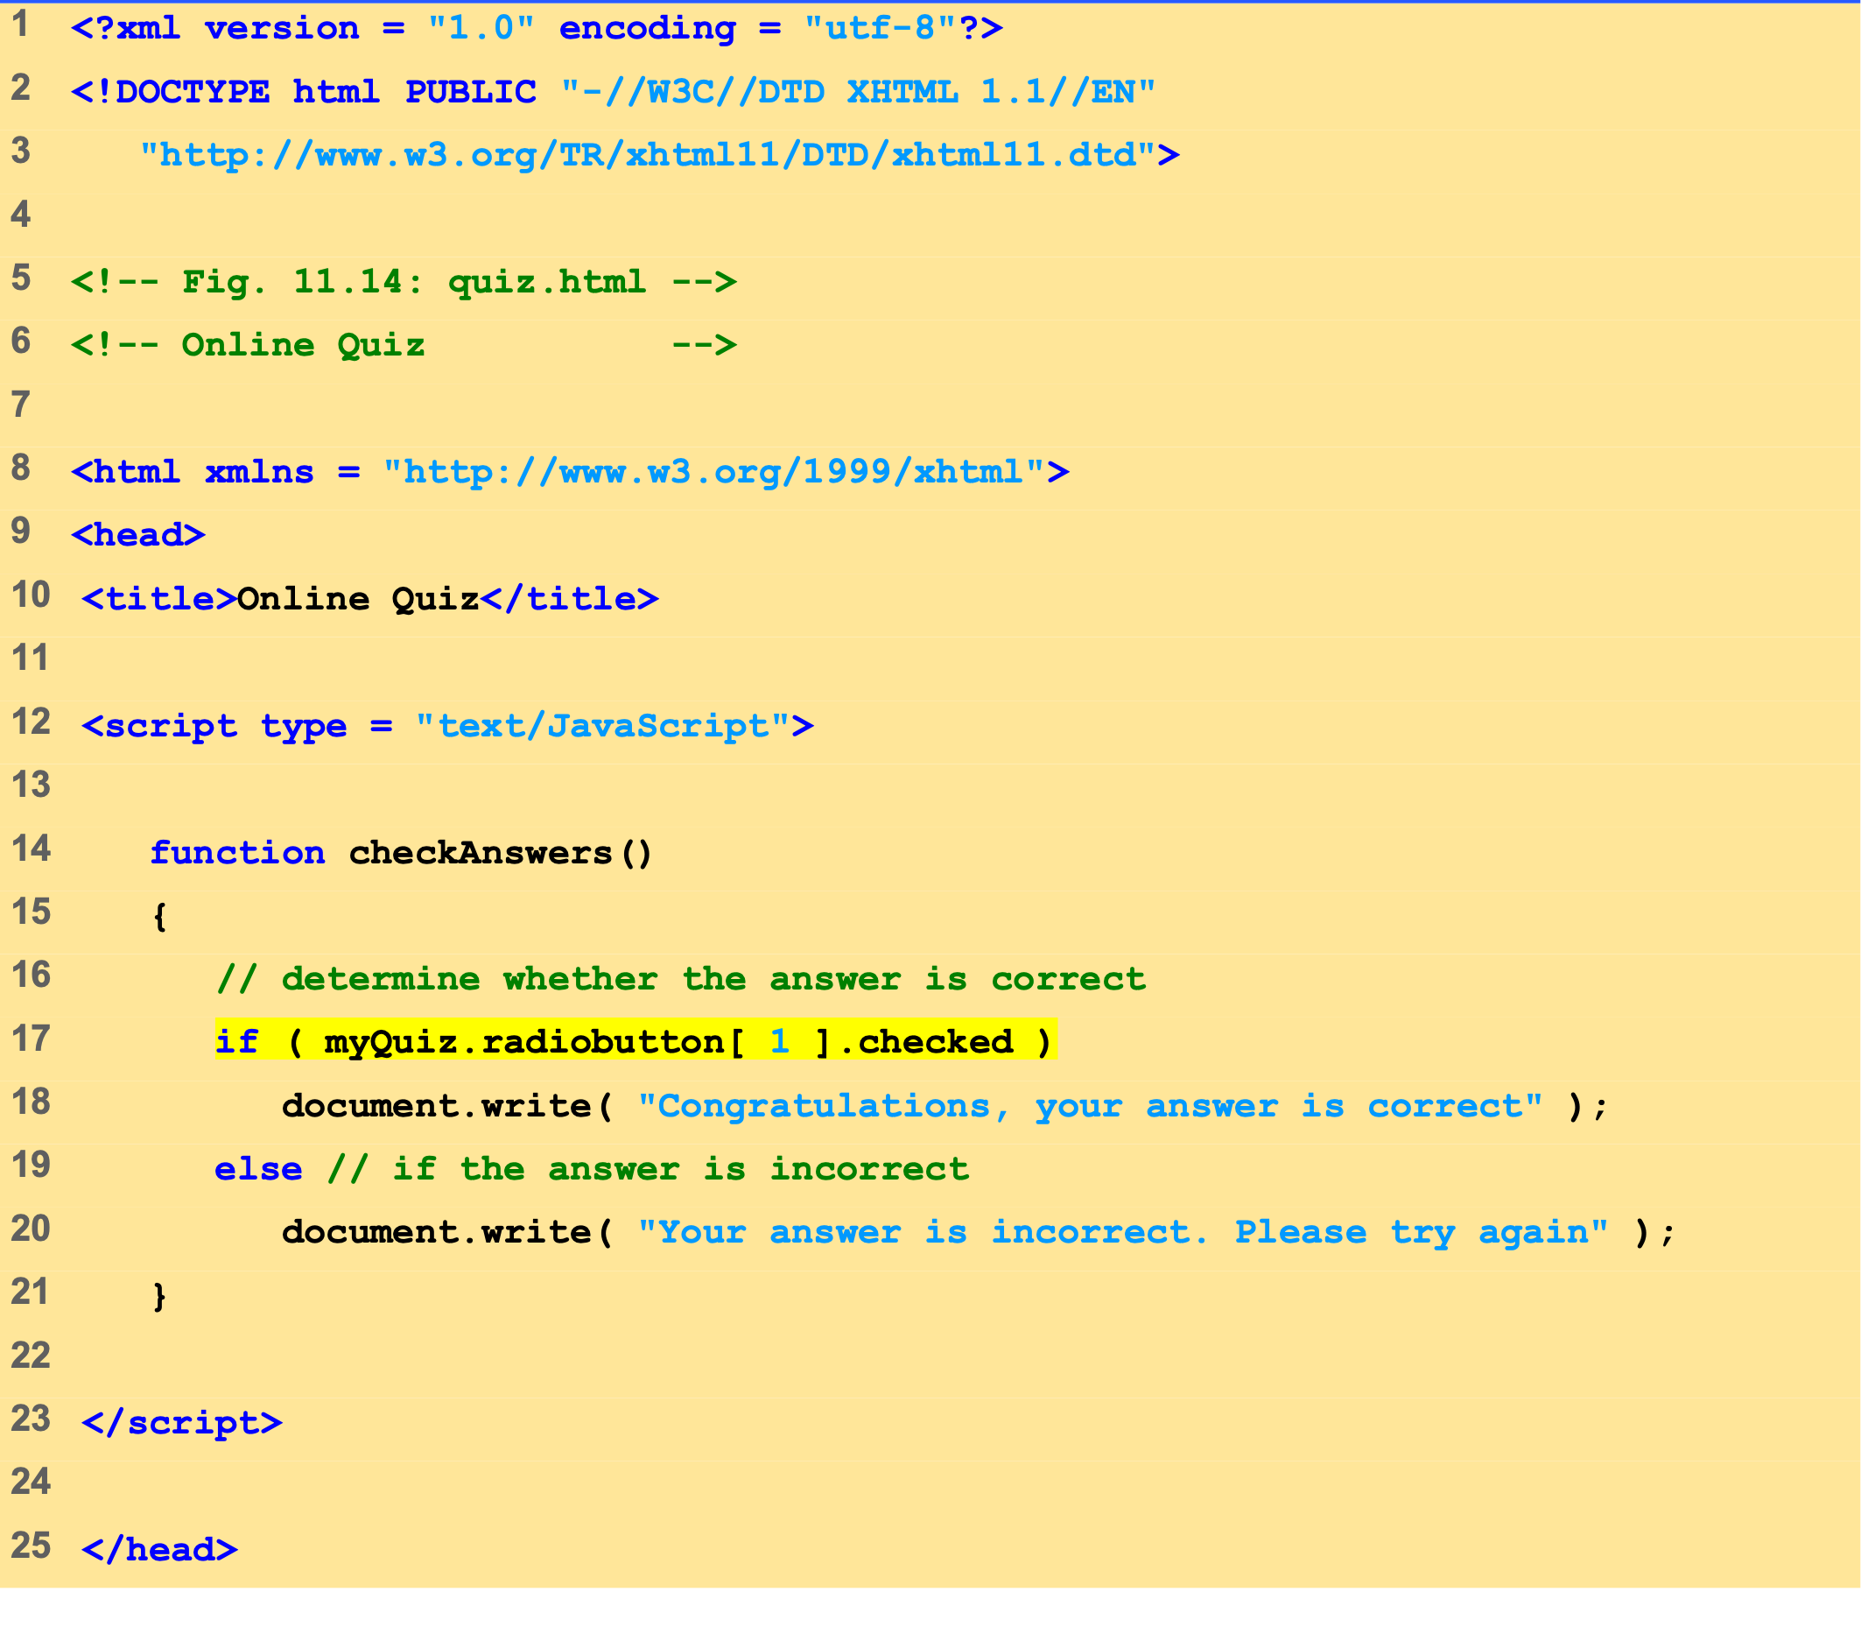
Quiz.html (1 of 2)
Determining the value of property checked.

Slide 58
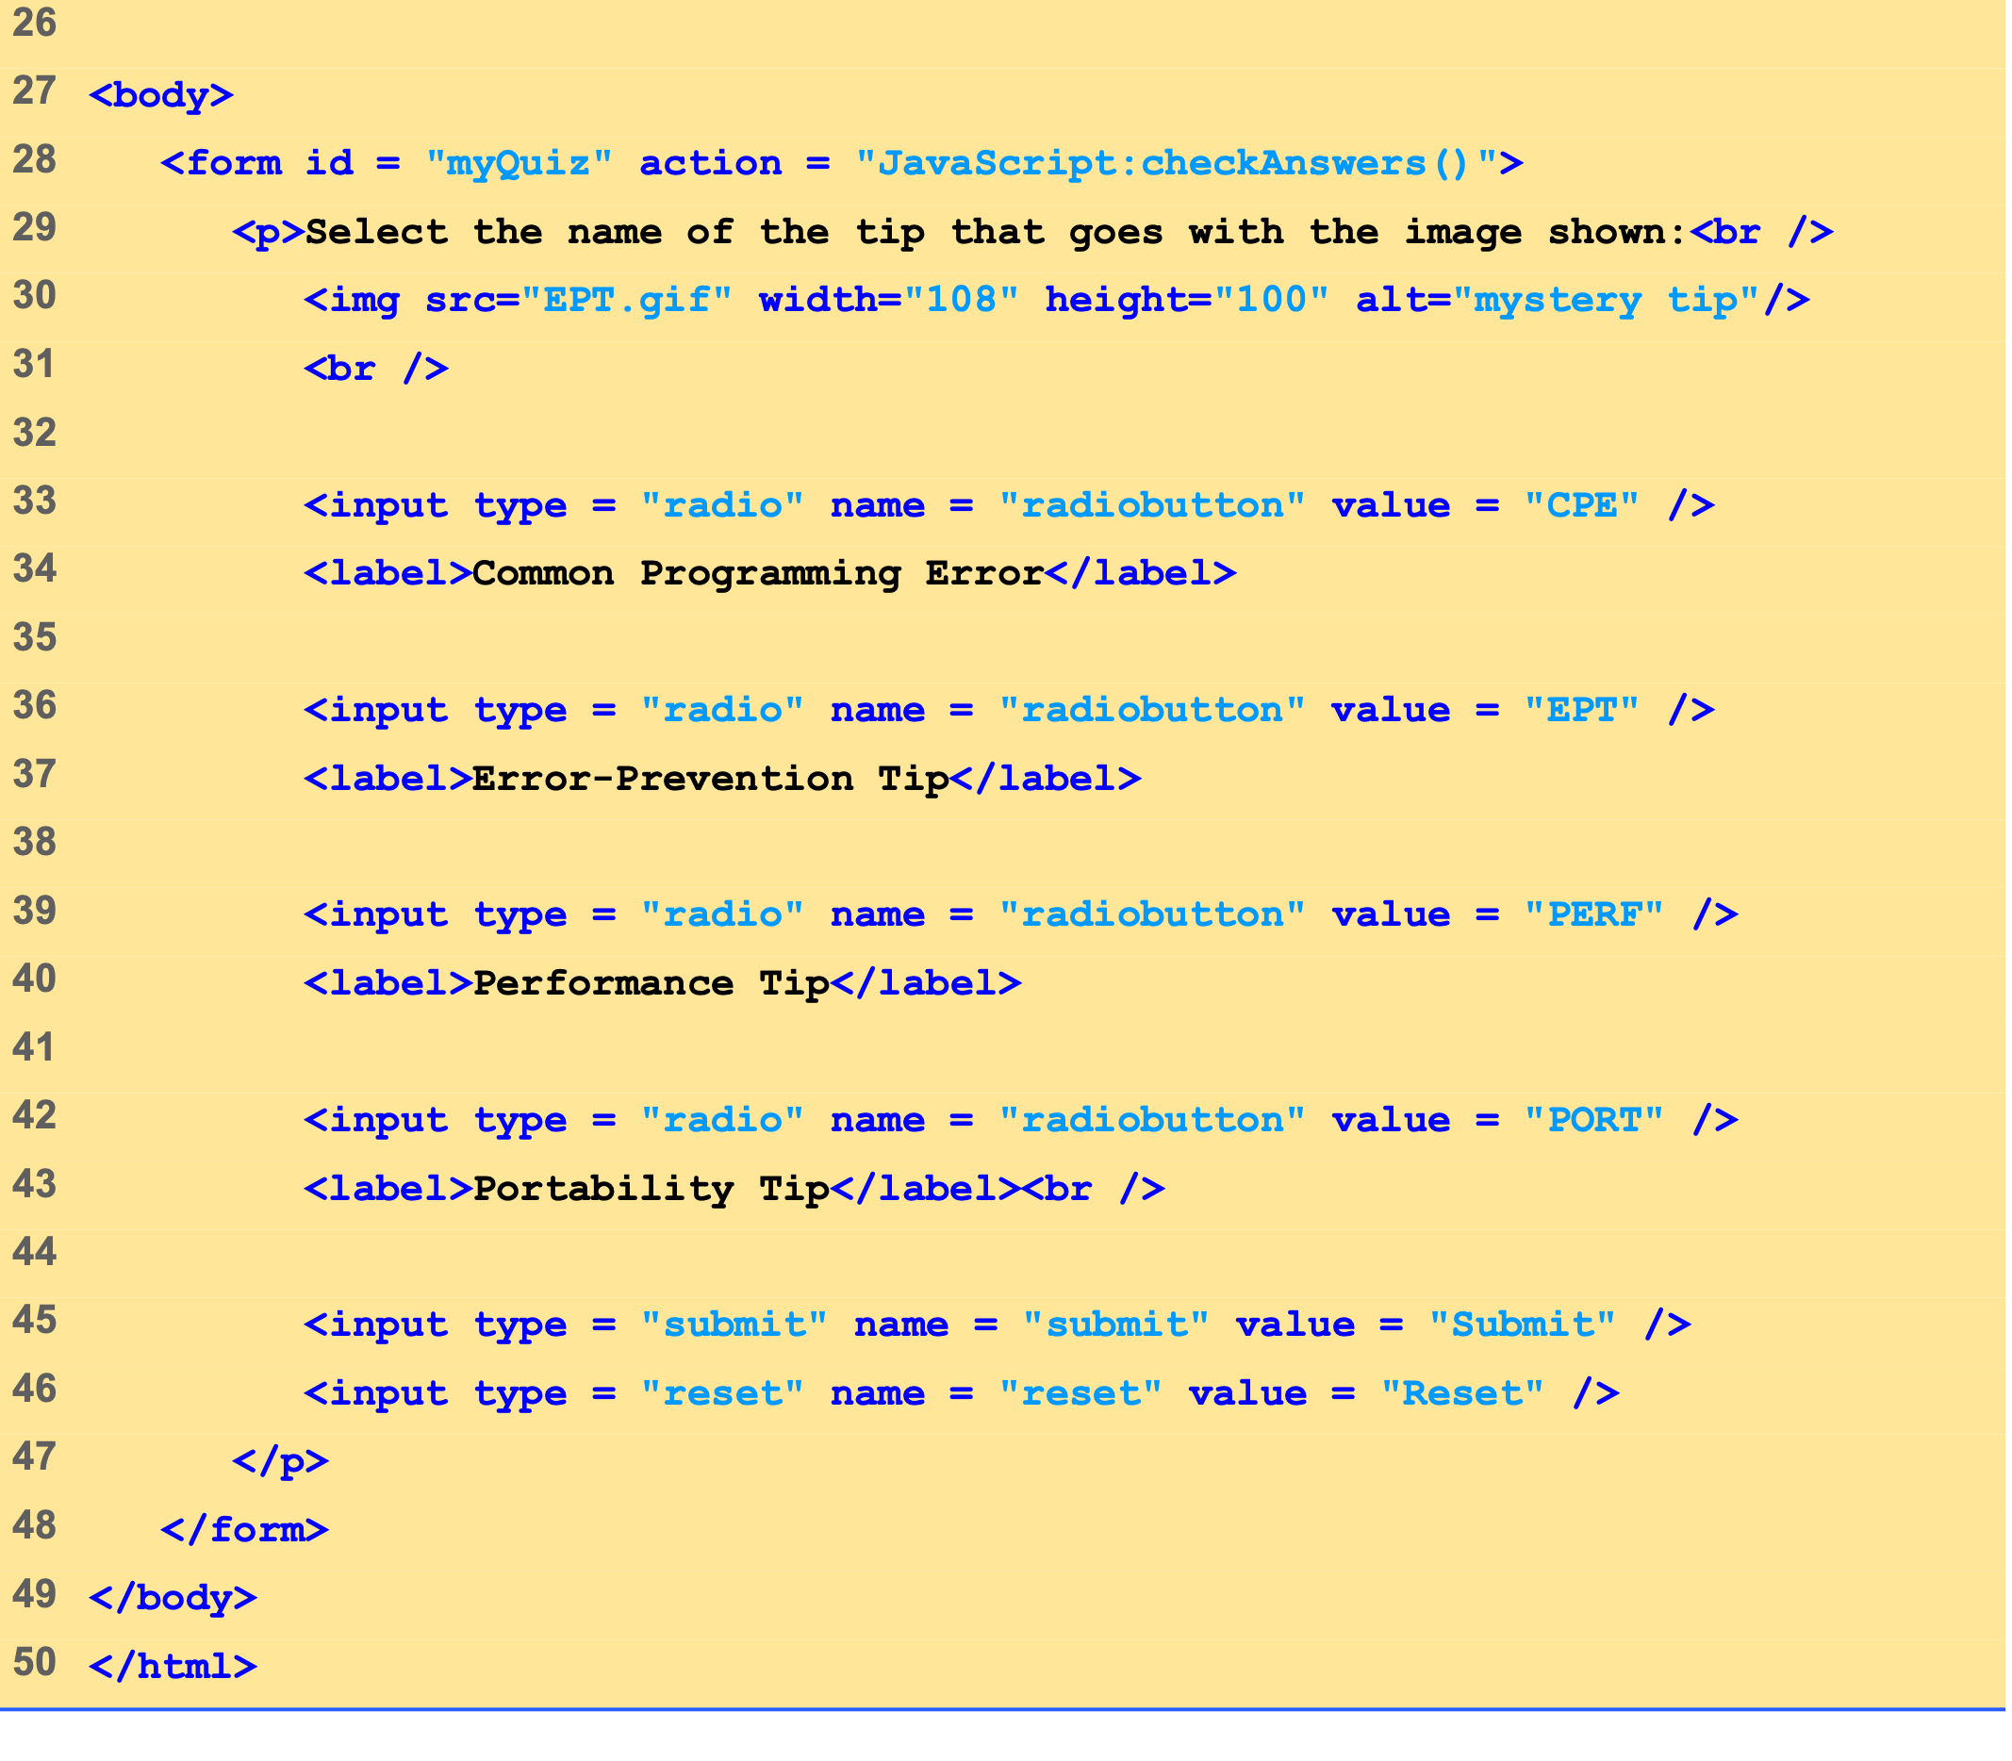
Quiz.html (2 of 2)
Call the checkAnswers function when the form is submitted.

Slide 59
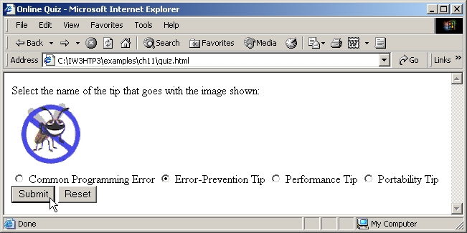
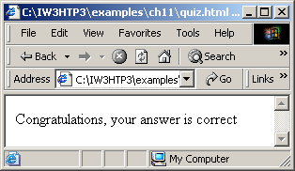
11 Building an Online Quiz
Online quiz graded with JavaScript.

Slide 60
Web Resources
www.javascriptmall.com
developer.netscape.com/tech/javascript
www.mozilla.org/js/language
Deitel and deitel, Internet and World Wide Web How to Program: Third Edition

